Slide 1

Welcome to this week’s presentation & conversation hosted by the Canadian Association for the Club of Rome, a Club dedicated to intelligent debate & action on global issues.
The views and opinions expressed in this presentation are those of the speaker & do not necessarily reflect the views or positions of CACOR.
CACOR Live Sector Coupling of Electricity and Thermal Systems: Our Biggest Opportunity for GHG Reduction.
Profile: Michael Wiggin is a retired engineer who managed energy systems research at NRCan and advised PWPSC on modernizing their district heating system in Ottawa. He is Senior Advisor to the IEA District Heating and Cooling Technology Collaboration Party, Deputy Chair of the Ontario Society of Professional Engineers Energy Task Force, and a Director of the Boltzmann Institute. The Boltzmann Institute has recently released a major "2 Pathways" report comparing the electrification of building heating with the use of thermal networks Boltzmann Institute website. He is frequently consulted on the emerging opportunities for sector coupling.
Summary: Michael will explore how thermal energy networks or modern district heating systems can link low-grade heat demands for building heating with sources of rejected heat and harvest sources of decarbonized energy not accessible by individual buildings. He will examine such options as seasonal thermal energy storage and nuclear CHPs, not because he advocates using nuclear energy, but because we are moving ahead with nuclear generation with no provision for useful heat recovery. Pickering Nuclear Generating Station alone could heat most of Toronto.
CACOR acknowledges that we all benefit from sharing the traditional territories of local Indigenous peoples (First Nations, Métis, & Inuit in Canada) and their descendants.
Website: canadiancor.com YouTube: Canadian Association for the Club of Rome 2025 Nov 12 Zoom #269 Donate to CACOR

Slide 2

Sector Coupling of Electricity and Thermal Energy Systems:
Our Biggest Opportunity for GHG Reductions
A Presentation to CACOR – November 12, 2026

Slide 3
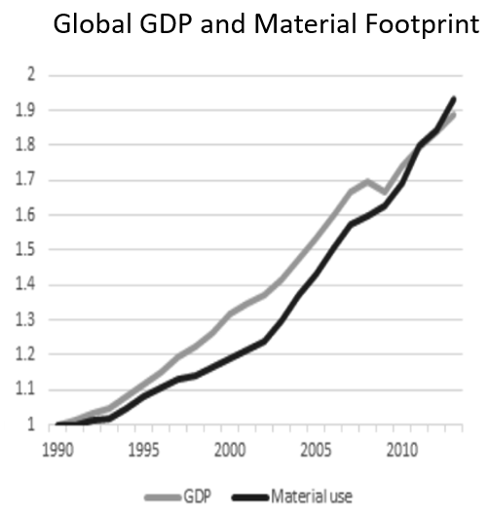
Symptoms? Or root causes?
Strong correlation between GDP and Material Extraction.
Same for GHG emissions
Together, they affect Climate Change and Biodiversity.
Increasing societal efficiency through the use of reject heat may not be enough!
But let’s start with thermal energy systems.

Slide 4
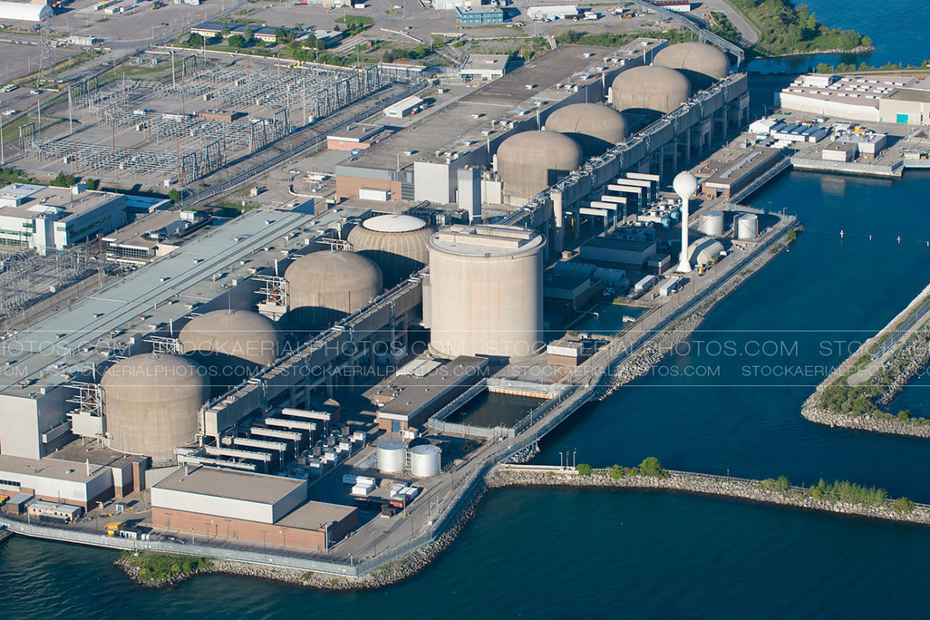
Change Takes Work
The focus today is on nuclear CHP but the opportunities are much broader than that; other CHP, electricity systems, waste/rejected heat and renewable energy.
The nuclear industry is justifiably cautious – safety, operational and regulatory concerns.
There opportunities are so significant that addressing these concerns is justified and deserved. Other countries are doing it - and so can Canada.
More heat is rejected from existing nuclear plants in Ontario than the building heating energy from natural gas.

Slide 5

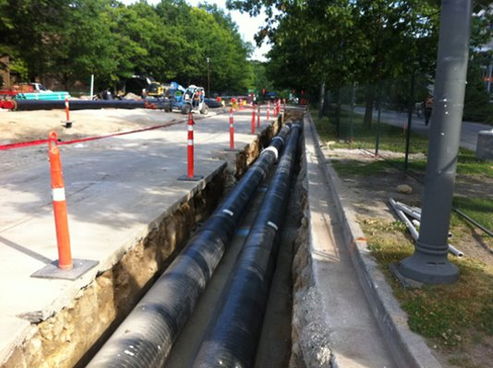
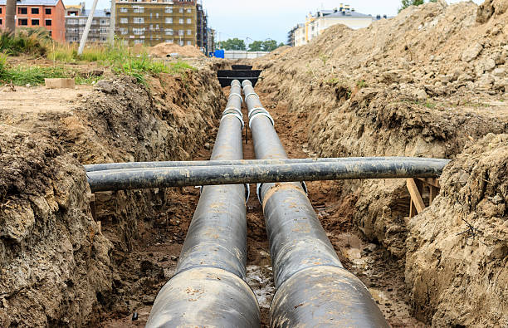
What is a Heat Network?
Municipal infrastructure like road, sewer or water supply renewal is not uncommon and short disruptions are accepted by the public as necessary and acceptable. Thermal networks are no different. Shallow buried technology allows heating pipes to be installed above existing infrastructure and disruption is similar or less than other infrastructure.
Pre-insulated district heating pipes have been widely used in Canada since about 1982. Frost or freezing is not a problem and pipes are only buried deep enough for structural protection; typically 600 mm to 1000 mm cover.
Underground infrastructure is advancing. Horizontal drilling and other techniques can construct service connections to buildings with minimal disruption.
Smaller pipes, below 400mm diameter, are available in high density polyethylene (PEX) rolls and can be routed around other utilities, trees etc.

Slide 6
Key Problem – Peak Load Management
With fossil fuel infrastructure, we have not had a serious problem with meeting peak loads.
If natural gas is removed as a source of GHG emissions, what is the impact on the Electricity System?
How might this be managed by integrating the planning and operation of electricity, thermal and, in the near term, natural gas utilities?
Nuclear has been a popular response – but with inadequate appreciation of thermal energy loads.

Slide 7
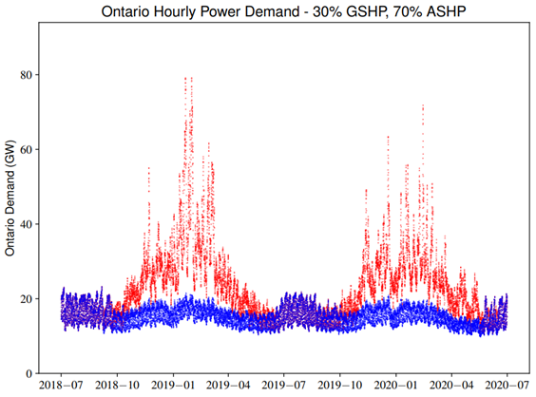
HEATING IS SOMETHING COMPLETELY DIFFERENT!
Ontario Electricity Peak Load – 23 GW
Ontario Peak Load on Natural Gas – 70 GW
Current Utilization – 67%
Utilization with Heat Pumps – 26%
Incremental utilization of ASHPs - <10%
Impact on electricity rates?

Slide 8
IMPACT OF ELECTRIFICATION OF BUILDING HEATING
A load duration curve for heating reveals a utilization of capacity of only 25%
Without fossil fuels, this is a challenge.
With Air Source Heat Pumps, the utilization drops to less than 10%
Good for customers but terrible for electricity utilities.

Slide 9
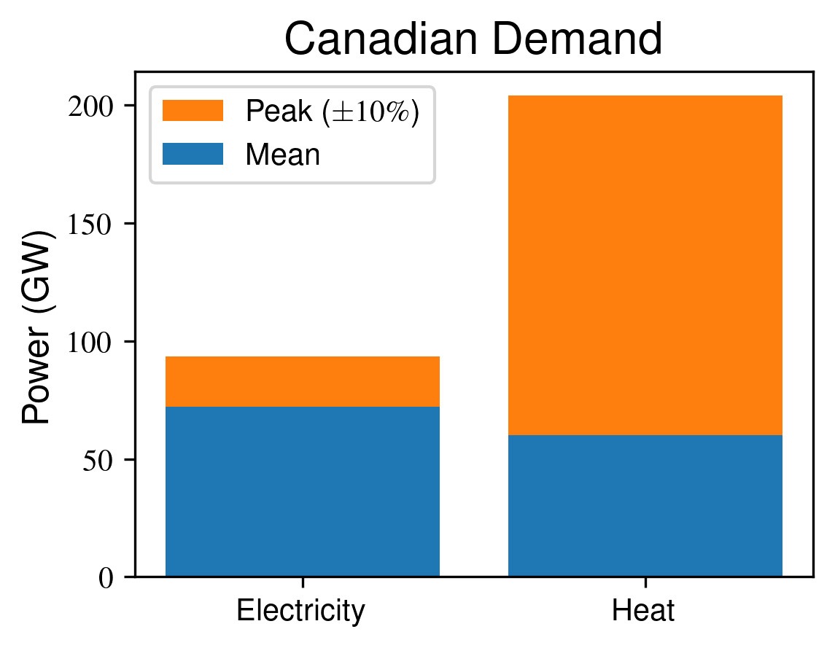
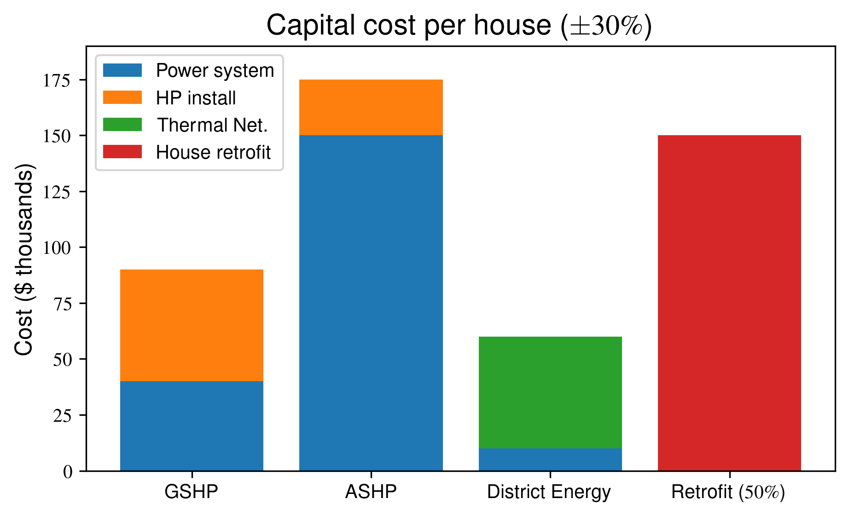
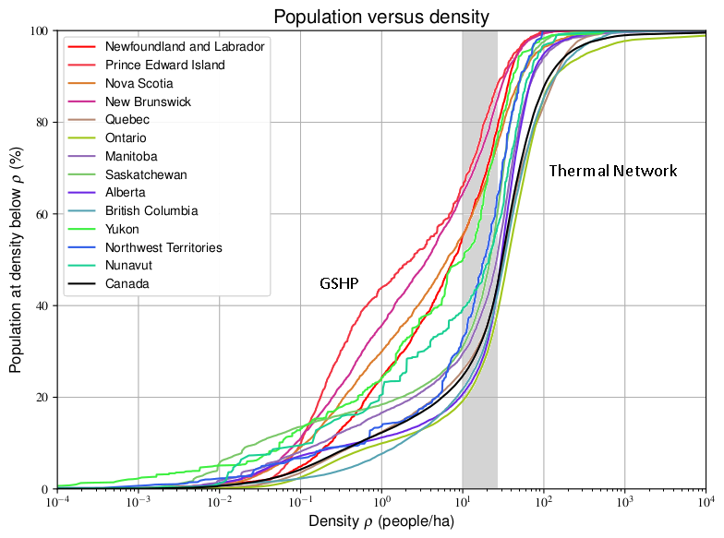
The Ambition Explained
Thermal Networks (TNs) offer the potential to be an integral part of Canadian integrated community energy systems and the primary infrastructure to facilitate the decarbonization of Canada’s urban thermal delivery system.
TNs have the potential to provide non-rural communities across Canada with the backbone of reliable, affordable, decarbonized space heating and hot water for buildings, at scale. By using low-cost seasonal TES to store heat harvested from multiple clean sources, TNs may economically address the peaky winter demand for heat.
While TNs use pipes to distribute thermal energy, they are combined with distributed thermal and electrical energy resources, thermal energy storage (TES), and seasonal TES (STES) which are intelligently operated for the benefit of the electrical grid.
TNs have the potential to avoid the low system utilization that is characteristic of electrified heating. Savings by avoiding electrical infrastructure needed for building heating may far exceed the cost of the alternative TN infrastructure. Using energy sources such as electricity or renewable liquid or gaseous fuels directly within urban buildings to provide heat is also assessed to be less efficient, more costly and not feasible at the needed scale. [Boltzmann 2023]
Ground source heat pumps (GSHPs) stay highly efficient even in very cold weather and are viable and preferred where heat demand per metre of pipe is too low for TNs – e.g., rural buildings.
Notes:
9

Slide 10
Business Options for Nuclear

Slide 11


Slide 12
Changing to nuclear CHP – Urgency!
The nuclear and electricity communities are comfortable with base load electricity production and change is resisted.
Operational and regulatory complications are a concern.
Retrofits may be limited in flexibility, but if CHP is incorporated at the design stage, the incremental cost may be less that 0.2%.
In Canada, there will be several major nuclear generating stations where commitments to design will be made within 5 or 6 months.
It is urgent that CHP is considered NOW.

Slide 13
Consequences of CHP, Thermal System Integration
Unprecedented reduction in GHGs
Nuclear CHP plants become more cost effective, potentially doubling revenues.
Smaller SMR and MMR become more cost effective and deployment advanced
Expansion of Electricity System (generation and distribution) is greatly diminished and “historic investments” avoided
Nuclear generation efficiency increases from 33% to about 90%
Renewable energy and waste heat utilization expand in a more cost effective and productive manner
The electricity prices could be kept much lower than with electrification

Slide 14
References
https://ospe.on.ca/advocacy/ospe-launches-advocacy-for-thermal-energy-in-ontario/
https://ospe.on.ca/advocacy/ospe-launches-advocacy-for-thermal-energy-in-ontario/
Boltzmann Institute Website: https://bi-ib.ca/
2 Pathways Study Executive Summary:
https://bi-ib.ca/wp-content/uploads/2025/06/Two_Pathways_Executive_Summary.pdf
2 Pathways Report:
https://zenodo.org/communities/twopathways/records?q=&l=list&p=1&s=10&sort=newest
OSPE Position
https://ospe.on.ca/advocacy/ospe-launches-advocacy-for-thermal-energy-in-ontario/

Slide 15
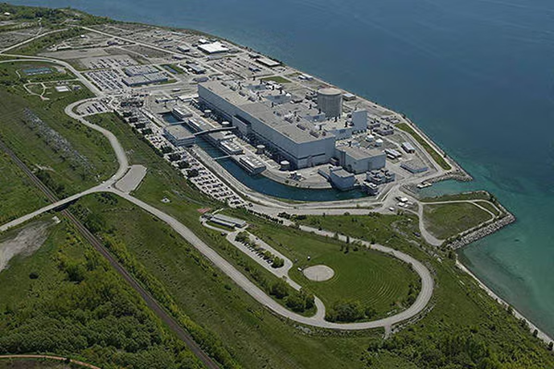
Today Let’s focus on the nuclear industry
We could ask:
What business does the nuclear industry want to be in?
What business does Canada (or the world) want them to be in?
Thank you. Michael Wiggin, Director, The Boltzmann Institute (bi-ib.ca)

