Slide 1
Project Payback: A Community Virtual Power Plant
Grid Modernization Based on Local Resources
By
Dr. Art Hunter and Dr. David Head
Canadian Association for the Club of Rome (CACOR)
1

Slide 2
Importance of Electrical Energy
Energy and technology are longtime drivers of humanity’s progress and prosperity by
Powering the world’s industrialization
Enabling dramatic improvements in living standards.
In just the past 40 years, the global energy system has contributed to
Lifting over 1 billion people out of poverty
Added 10-year increase in life expectancy
Increased literacy rates from 70% to 90%.
2

Slide 3
Make Money While Sleeping
Warren Buffett once said, "If you don't find a way to make money while you sleep, you will work until you die.“
Here is one way to sleep and thrive while actively participating in GHG mitigation and adaptation to some threats of climate change.
Increase renewable energy generation and improve energy efficiency.
3

Slide 4
Grid Defection
With 65% Grid Defection you are only using 35% of Prior grid energy.
100% Grid Defection means you are using zero energy from the grid.
In this project Grid Defection goes one step further and “trades” energy with the grid (both buy and sell) and it always sells much more than it buys to make a substantial profit.
4

Slide 5
“Zero Bills” energy home
This presentation explains why this home qualifies as a “Zero Bills” energy home (Grid Defection).
This is also an explanation for “Zero Bills” energy for Transportation.
This is an Electrify Everything and burn nothing home with 100% Grid Defection.
5

Slide 6
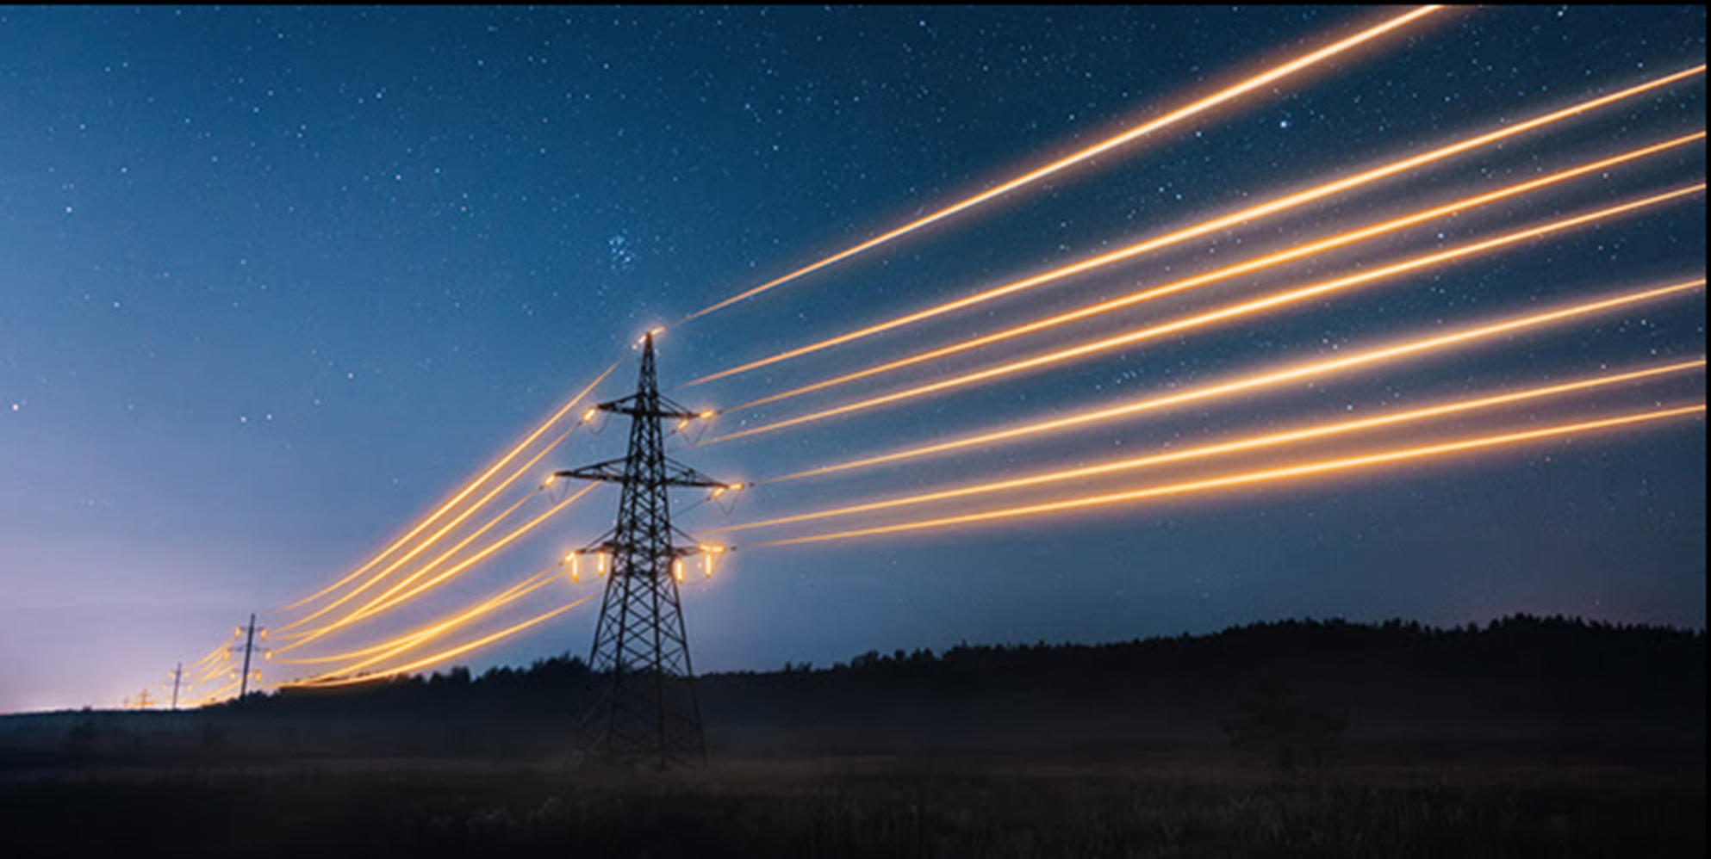
Interesting IR photo of 2% energy loss
Distant Generator to local load

Slide 7
The Presentation Content
Objective: To establish a Virtual Power Plant (VPP) in Ontario, Canada to demonstrate how the planet and people can thrive
Describe VPPs and V2G, their usefulness and benefits
Demonstrate how VPPs can unlock a new revenue stream by facilitating participation in energy markets
Describe energy trading while time shifting loads
How the Ontario Ultra Low Overnight electricity rates are a policy designed to smooth demand and supply while providing electrification at scale.
7

Slide 8
Vehicle to Grid (V2G)
For V2G to function, the following three prerequisites are required:
An electric vehicle with V2G capability.
A compatible bidirectional charger.
The owner must participate in a V2G program such as a VPP.
8

Slide 9
Grid Connectivity
Device-agnostic connectivity supports more than 1,000 makes and models including EV chargers and their batteries as well as home or other DER battery storage systems.
This allows all new batteries and microgrids to become operational grid assets.
The aim is to bridge the gap between commercial energy assets and grid services. Both grid failure backup energy and peak power delivery are included in grid services.
9

Slide 10
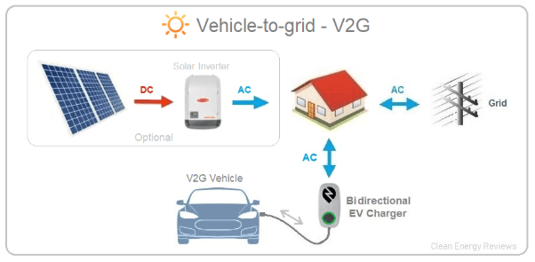

Slide 11
Value and Growth of Electricity
Value of electricity in people’s lives is critical to survival, communications, transportation, health and comfort
Electric Vehicle and Vehicle to Grid (V2G) deployment is projected to grow annually by 30% in 2025
Rooftop Solar, home batteries and BESS are combining with solar and wind farms and other DERs to become large microgrids which are also aggregating into massive Virtual Power Plants
This surge is driven by substantial financial benefits, grid reliability, efficiency, decentralization, aging grid infrastructure, sustainability, mitigation of and adaptation to climate change
11

Slide 12
Climate Change and BESS
There are 26 grid sized batteries in Ontario that are operational with 2,916 MW capacity. More (hundreds in the next decade) are under construction or in planning.
BESS is a well-developed technology used extensively in Australia, China, EU, UK, USA , and in other parts of Canada.
Climate threats dictate we electrify everything using Distributed Energy Resources (DER) to stop burning fossil fuels.
Substantial growth demands are placed on an aging centralized generating system
DERs must be closer to the demand loads to reduce use of transmission and distribution towers, transformers and their wired resistive losses
Enthusiastic support of the BESS program is vital to reducing delivered energy rates, improve resilience, reliability and flexibility.

Slide 13
BESS Primary Uses
Peak Shaving. Provide power to the grid during 4 p.m. thru 9 p.m. peak demand. This is an energy time shift of expensive high-cost energy demand discharging to cheap overnight battery energy charging.
Demand Response. As the total power demand changes over 24 hours, the demands can be very dynamic including non-linear large industrial loads.
Prior history provides a rough model of demands, but each day is unique.
Grid services. Local variation of AC frequency, phase and voltage levels need cleaning. BESS is a renewable energy quality control cleaning tool.

Slide 14
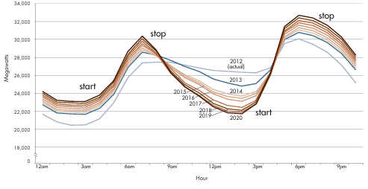
Two daily Peak Shaving (the Duck Curve for 11 January Net Load)

Slide 15
Demand Response
Rapid power demand growth exceed the ability to activate
an idle nuclear reactor,
starting up another water turbine,
starting a gas turbine,
turning off discretionary loads
Random grid failures due to severe weather, aging equipment or accident are common.
Manual inter jurisdictional energy trading (Quebec, Manitoba, New York, Michigan) is a temporary solution for slower trends.
BESS can respond almost instantly

Slide 16
Grid Services
Local grid following DERs (solar and wind generators) deliver small variations of AC frequency, phase and voltage levels that need BESS cleaning
Intentional AC frequency variation is a common temporary Demand Response action
Significant quality control issue.
Continual DER expansion based on population growth (more housing and industry demands) to deal with.
EV charging,
Buildings decarbonizing heat pumps,
AI Data centres rapid growth
Aggregation of home solar arrays paired with batteries into microgrids, and Virtual Power Plants need grid following BESS cleaning
. BESS design can prevent the recent Spain/Portugal grid failure mode.

Slide 17
What is Happening on Ontario’s Electrical Grid?
Growth of Ontario’s annual grid energy demands is estimated at 75% growth to 2050. (From 2008 to 2016, residential electricity costs rose by 71%)
Disruption forces driven by
electrify everything (housing, industry, transportation)
consumer participation and cost savings
grid energy efficiency, sustainability and reliability
regulatory support and policy initiatives
increased public awareness in future proofing their homes
VPPs are systems that respond to this opportunity
17

Slide 18
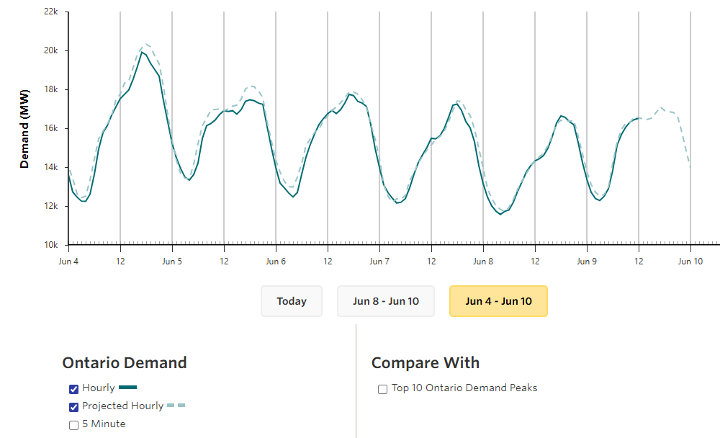
Ontario’s Electrical Non-linear Demand
18

Slide 19
The Constraints of Nuclear Energy
Mainly inflexible and “fixed reactor output is always on or off” with limited reactor control
Dumping some of the steam into turbines provides ramping down/up electricity generating flexibility
Utilities seek means to absorb excess power and heat providing more flexibility
Moving household demands to after peak hours will assist in use of this excess nuclear-electrical energy
Home, EV and utility batteries help smooth energy demand to match the “fixed” supply
19

Slide 20
A Pilot Project Proposal
Pilot Project could be in any community in the province or the entire province (Own and control is central)
Main considerations are affordability, reliability, resilience, equity, and decarbonization (sustainable)
Emphasis in this presentation is affordability, but it is hard linked to the other considerations - all benefits come in a single package
Aggregation of Solar PV generation paired with home batteries, but thermostat controls are also used
20

Slide 21
Virtual Power Plant “the energy system of the future”
VPP consolidates and streamlines customer clean 24/7 energy
Reduces grid strain (transmission and distribution) and growth
Controlled by the utility for peak load shaping and cost savings
Financial Benefits
Local Microgrid and DER owners are paid for each kWh delivered.
Utility can delay upgrading distribution infrastructure (towers , poles, transformers, wire gauge) as demand growth is reduced
All customers get reduction in electricity cost escalations due to less costs for building grid infrastructure and no need for rushing construction of new centralized generation plants (nuclear, gas turbines, hydro)
21

Slide 22
Virtual Power Plant Types
Two types
Demand Response (DR) VPPs: These focus on adjusting consumer demand for energy through various methods, such as price signals or incentives, to alleviate pressure on the grid during peak times.
Supply Side VPPs: These are oriented towards managing the supply of energy from various distributed resources, ensuring a balanced and reliable energy supply.
22

Slide 23
Virtual Power Plant Five Applications
Grid Support Services: Providing essential services to maintain the stability and reliability of the grid, including voltage control and frequency regulation.
Renewable Energy Integration: Aggregating renewable energy sources, promoting a cleaner energy mix.
Peak Load Management: Manage peak load periods, reducing the need for additional generation capacity and improving overall grid efficiency.
Grid Resilience: Serve as backup power sources during outages.
Load Following: Adapt to changes in demand, ensuring that energy supply meets real-time consumption.
23

Slide 24
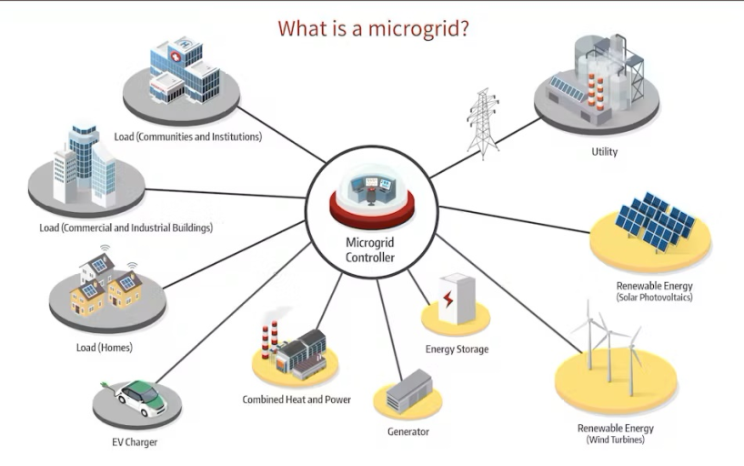
Typically, all these parts are in one geographic location.
X
Switch – DER to Microgrid
24

Slide 25
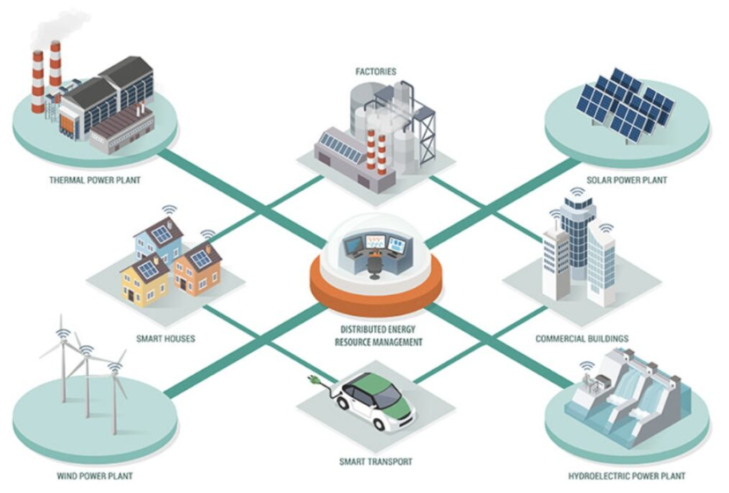
What is a Distributed Energy Resource?
25

Slide 26
The Decentralized Grid
The decentralized grid is:
an electric network of distributed energy resources and end-use customers (loads)
interact with each other and/or with the central grid
to improve efficiency, lower costs, reduce emissions, enhance both local and system resilience,
provides greater local control and energy independence
capture more of the economic benefits locally
capture local health benefits from these energy assets.
26

Slide 27
The Manotick Microgrid Home of Art Hunter
Consists of:
rooftop solar array – 5.5 kW maximum production
three Tesla “Powerwall 2” NMC (nickel, manganese, cobalt) batteries – 40 kWh storage
two electric Vehicles – Tesla model 3 (80 kWh NMC battery) and Mitsubishi i-MiEV (14 kWh NMC battery)
Ground Source Heat Pump – shelter heating and cooling plus hot water
Tesla Powerwall control system with Smartphone App
Most homes are not this well equipped but could be
27

Slide 28
Virtual Power Plants
Virtual power plants (VPPs) are an aggregation of small-scale distributed energy resources including:
Microgrids
solar energy systems,
electric vehicle batteries (EVs), EV bi-directional chargers
demand response devices such as water heaters, thermostats, appliances
VPP’s and their collaborating DER technologies can grow and adapt with dynamic grid needs
28

Slide 29
Virtual Power Plants (defined in prose)
A Virtual Power Plant (VPP) is used to sustainably decarbonize part of an electrical grid. It decentralizes energy management to many locally controlled regions with cost reductions. This permits aggregation and growth of any source or load.
Reliability is delivered by the ability to isolate local outages. With great flexibility, they can collect millions of dispersed generation devices and billions of consumption loads. Managing both supply and demand at the nano scale greatly advances efficiency and resiliency.
A VPP then conducts energy and load shifting with the grid and delivers stable energy and services. Customizable algorithms streamline operations, affordability, and infrastructure maintenance.
Multiple VPPs are ideal for future demands of Electrifying Everything. This includes deployment of bi-directional electric vehicle chargers, heat pumps, and data centers.
29

Slide 30
How Basic Financial Benefits are Determined
Comparison of two homes which provides:
operational costs before and after adding solar panels
both before and after expenditures are changing in real time
“Microgrid” home same design as the traditional home
only electric energy financing as no fossil fuels are burned
Dr. Art Hunter resident
“Traditional” same original home design in same location as the Microgrid home
with electricity, natural gas & gasoline costs
Dr. David Head resident
30

Slide 31
Payback Demonstration Project
Demonstration project initiated in December 2023
Use the Manotick Microgrid to mimic a Virtual Power Plant
Objectives:
Save money using optimized energy trading with the grid and load shifting to reduce electricity energy costs
Save “energy credits” produced in summer for winter use
31

Slide 32
Microgrid vs Traditional Seasonal Costs
32

Slide 33
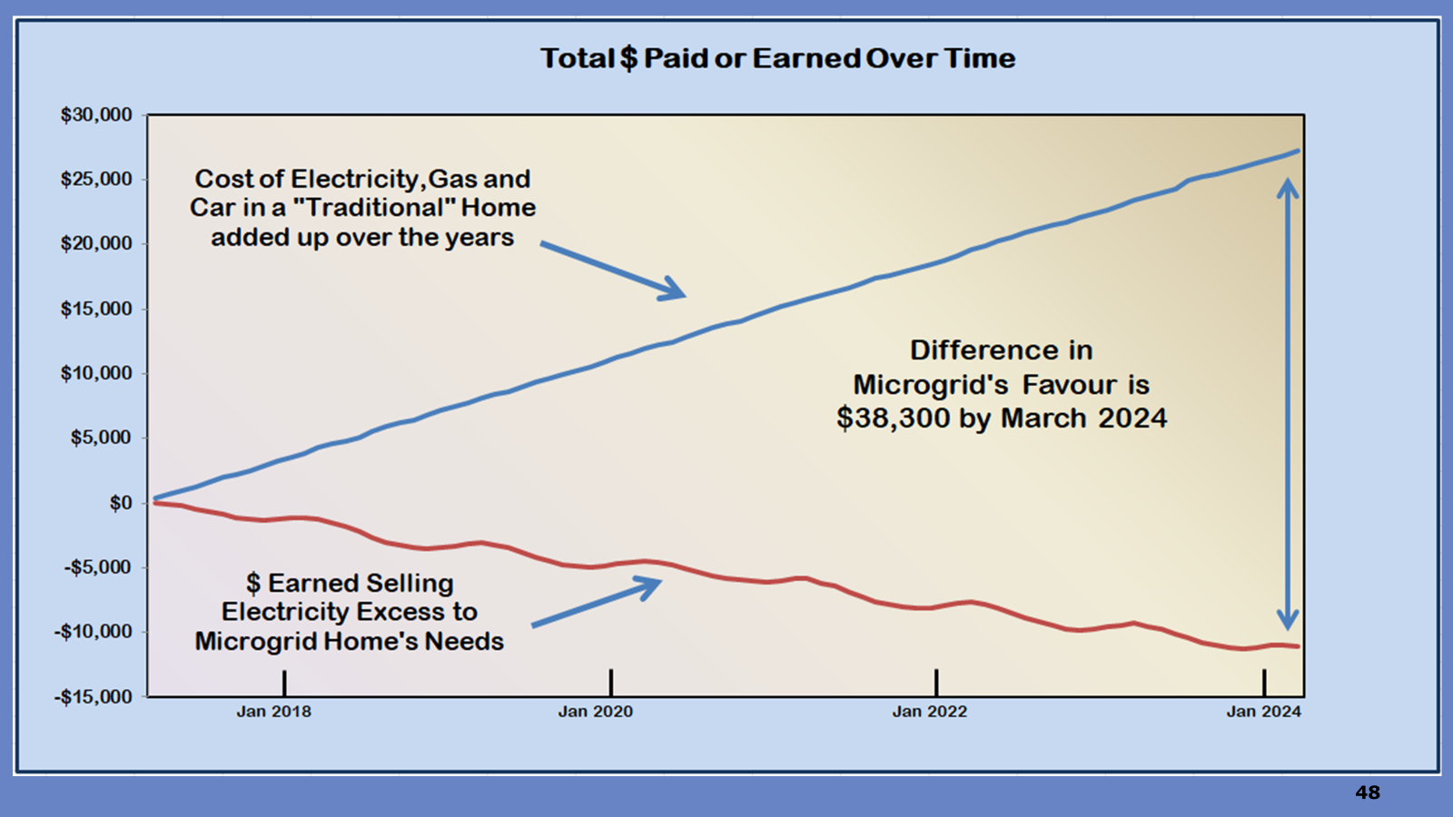
Payback over 7 Years
33

Slide 34
Observations
$22,000 was Installation cost of 5 kW Net Metering solar array
Significant Microgrid earnings in the summer and some costs in the winter
Over time energy earnings (sell) far exceeds the costs (buy)
Traditional home has far less seasonal variation but always has a cost without any earnings
34

Slide 35
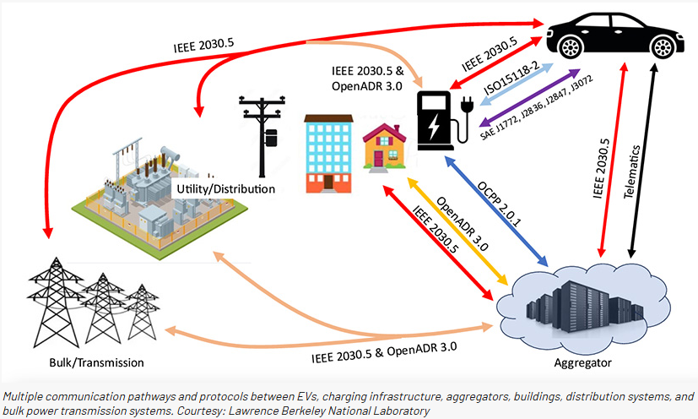
EV Smart Charge Management
Six systems interfacing
35

Slide 36
EV Smart Charge Management
There are no uniformly adopted standards for EV bidirectional power flow protocols with:
home and public charging infrastructure,
utilities,
the grid
no requirement to comply with any standard but EV batteries must be considered identical to home batteries or as mobile microgrids.
“difficult” for vehicle manufacturers to determine how to build smart charge management into their vehicles. Standard policies and interfacing protocols are needed.
36

Slide 37
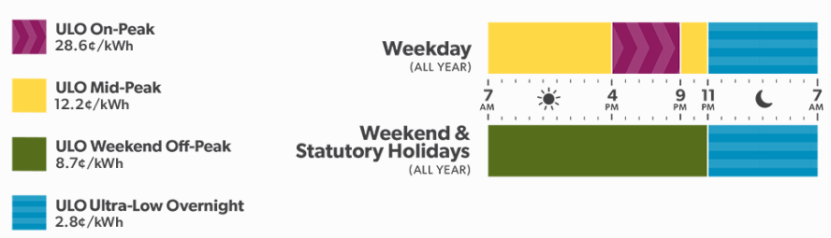
Encouraging Demand Shifting (do it yourself energy management)
Regulated Ultra Low Overnight (ULO) Rate Structure in Ontario
buying and selling dynamic pricing based on time of day
rates must target efficiency, effectivity, and equity
rate structure to encourage solar producers to remain on the grid to prevent utility death spirals by defection
rates are reviewed annually on 1 November
37

Slide 38
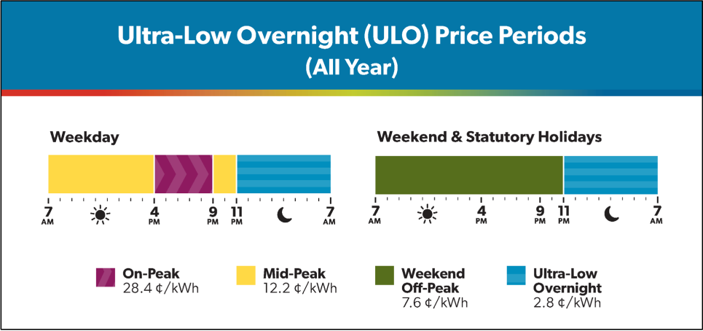
Periods of Extremely Low Overnight Pricing
38

Slide 39
Energy Trading daily and seasonally shifting
Energy Trading: buying electricity at utility’s low $ rate
and selling at high $ rates
Daily time shifting = moving daily household loads, out of the Peak high-rate times using batteries
Rate Shifting is permanently moving EV charging to the lowest energy rate using timers
Seasonal Shifting is the process of accumulating energy credits from your local utility for use the following winter
39

Slide 40
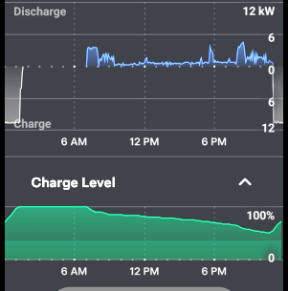
Dual Use Battery Energy Trading daily time shifting
Energy Trading: Battery discharge at high energy $ rate
and charge at low energy $ rate
Top blue curve is battery discharge from 7 a.m. to 11 p.m. It is set to an all-day window when high rates apply
Discharge was 18.5 kWh or about 46% of battery capacity.
Will not wear out an NMC battery at 17C.
Recharge (white) from 11 p.m. to 1:30 a.m. at $0.028/kWh.
Lower green curve is State of Charge level over time
66% capacity for energy trading, 33% grid outage standby - always ON settings
40

Slide 41
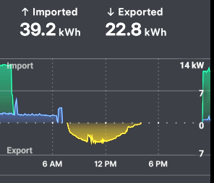
Grid Imports/Exports Energy Trading earned $2.44 this day
Home load for 7 hours from 00:00 a.m. to 7 a.m. overnight import from grid at ULO rates (blue) and battery charging (green)
At 7:45 a.m. the sun rose and exported all generation to the grid until 4 p.m. (yellow) = $2.78
At 4 p.m. to 11 p.m. no grid energy trading action after sunset
At 11 p.m. the grid importing ULO rates came back into force for battery charging and home loads (green and blue) = $0.34
41

Slide 42
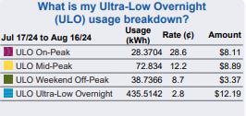
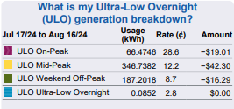
Hydro One Buy (usage) and Sell (generation) August 2024
Total $32.56
Total $77.60
Date ending | Month # | Prior accrued | Monthly addition | Total
16-Apr-24 | 1 | $ - | $ 10.71 | $ 10.71
14-May-24 | 2 | $ 10.71 | $ 30.50 | $ 41.21
15-Jun-24 | 3 | $ 41.21 | $ 54.55 | $ 95.76
17-Jul-24 | 4 | $ 95.76 | $ 46.29 | $ 142.05
16-Aug-24 | 5 | $ 142.05 | $ 42.05 | $ 184.10
42

Slide 43
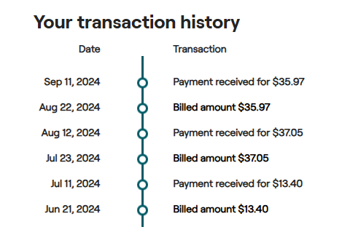
Directly from Hydro One billing history – Connection fee only

Slide 44
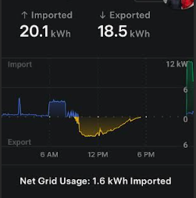
Grid Imports/Exports First spring day on Feb 26, 2025
Home load grid purchase from 00:00 a.m. to 8:30 a.m. (blue)
At 9:00 a.m. the snow slid off the arrays in spectacular sudden step in solar exporting (yellow)
At 4 p.m. notice the little sudden up/down in yellow. That is due to the software stopping battery charging and grid exporting all solar energy for $0.28/kWh.
At 11 p.m. grid energy battery charging (green) at $0.028/kWh
44

Slide 45
Mathematical Model Design
Balance supply and demand with Energy Trading using
Home battery and its mobile microgrid
Electrical grid acting as an external battery
Trading using these storage “batteries” is highly strategic
Design and develop strategy to minimize homeowner costs
Use previous experience to predict energy credits
Correct this prediction with actual measurements
Use AI to learn the trading quantities for the next prediction and correction
45

Slide 46
Virtual Power Plant “Simulator” Mathematical Model
Use previous measured facts
Prediction: model suggests energy flows and energy credits of December 2024 to be the same as December 2023
A rough estimate in the prediction
weather, monthly collected solar energy and monthly home power consumption never the same each year
Math model
applies a “correction” to reduce uncertainty in the “prediction”
Correction
based on actual utility measurement for the prior month with AI learned correction adjustments
Model termed a “Predictor-Corrector Simulation”
46

Slide 47
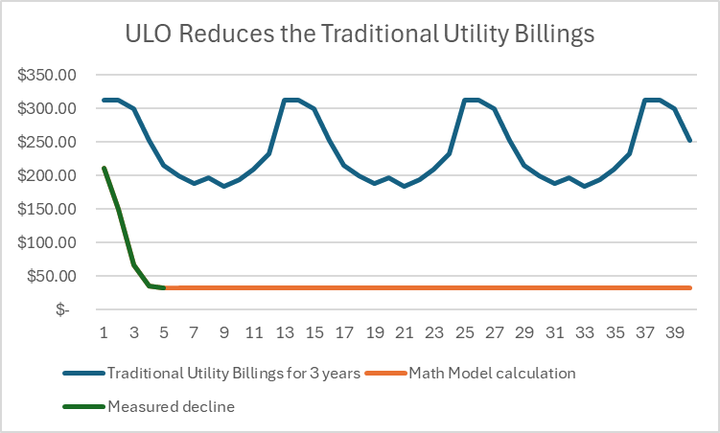
ULO + 5 kW Solar Generation Reduces Utility Billings
Blue: billings on tiered rate over three years for traditional home (rates unchanged over 24-hour period)
Green: utility data for microgrid home show a rapid decline in the first 3 months of ULO rate plan
Orange: decline in next months to lowest possible billing – just utility connect fee ($36/mo)
Mathematical Model concludes billings will be just the utility connect fee into the future.
Months
47

Slide 48
Energy Credit Accumulation and Use
First 3 winter months of 2024 there were no excess credits and aggregation reserve remained $0.0
Rapid growth of reserve through the summer due to excess earned credits
Autumn and Winter starts the consumption of credits
Reserve credits drop to low point of $80 in March 2025
The 12-month rule released the $80 credit back to the utility.
April 2025, credit reserve starts to grow again
48
Notes:
48

Slide 49
Conclusions: Manotick microgrid mimicking a VPP
Time shifting energy loads off peak rates using ULO is a savings, but not highly significant compared to the solar trading benefits
Adding 5 kw of solar energy generation rapidly adds to savings with ULO because of daily energy rate variations
Adding more solar power once optimum is reached will not improve savings as it is not possible to pay less to the utility (Hydro One) than the minimum monthly connection fee
However, in the USA the utility also pays $2/kWh VPP peak demand participation
49

Slide 50
Virtual Power Plant Benefits Win, Win, Win
Financial Benefits (both grid supply expansion and demand reduction)
WIN: Microgrid owners may reduce utility payments to connection only ($36/month) and incentive participation of $2/kWh (about $600/year with complex rules)
WIN: Utility can defer future upgrades of delivery infrastructure (towers, poles, transformers, and wire gauge) as demand growth is reduced.
US study “VPPs could help reduce annual power sector upgrade expenditures by $35 billion in 2030.”
WIN: All customers and taxpayers receive reduction in electricity rate escalations as deferred future upgrades of distant new generation plants (nuclear, gas turbines, hydro).
US study “deploying 80-160 GW of VPPs by 2030 could avert as much as $10 billion in
annual new grid generator costs”
50

Slide 51
Microgrid Batteries - 7 Benefits
• Peak Shaving - Discharge during peak times to avoid or reduce demand charges
• Load Shifting - Shift energy consumption from one moment to another to avoid high prices
• Demand Response - Respond to utility signals when energy demand is high to earn money e.g. energy trading
• Backup Power - Use stored energy to power operations during a grid outage
• Solar Self Consumption – during daylight and at night (normal operations)
• Grid Services - Provide frequency and voltage support to the electrical grid
• Microgrid - Generate, store and manage energy with or without a connection to the grid for energy independence.
51

Slide 52
Rooftop Solar and Battery Expectations
Owners want a fundamental value proposition from solar and batteries. Specifically:
a lower electricity bill from their solar,
access to grid outage backup power from their battery,
battery to be capable of time of use management (both load shifting and energy trading) with no additional costs
eliminate mechanical inertia time delays and energy losses
52

Slide 53
IESO Vital Requirements
The IESO Grid managers are open to any technology that advances their three main goals.
Affordability
Reliability
Renewability
53

Slide 54
Virtual Power Plants Pathway for Widespread Deployment
VPPs requires progress on five imperatives:
expanding Distributed Energy Resource adoption with equitable benefits (increase public awareness),
simplifying VPP enrollment,
increasing standardization,
integrating into utility planning and delivered incentives visible on monthly billings,
integrating into wholesale markets.
54

Slide 55
Virtual Power Plants Affordable Pathways to Energy Ecosystems
Energy storage within VPPs are delivering reliability while simultaneously lowering costs.
Through continued innovation and strategic planning, VPPs will undoubtedly become a foundation stone of modern grid management, revolutionizing the way we generate, store, and consume energy.
This transformation is not just about technology but also about creating an energy ecosystem that is adaptive, responsive, and aligned with the broader goals of sustainability and economic resilience.
Virtual power plants and the future of grid management | Smart Energy International
55

Slide 56
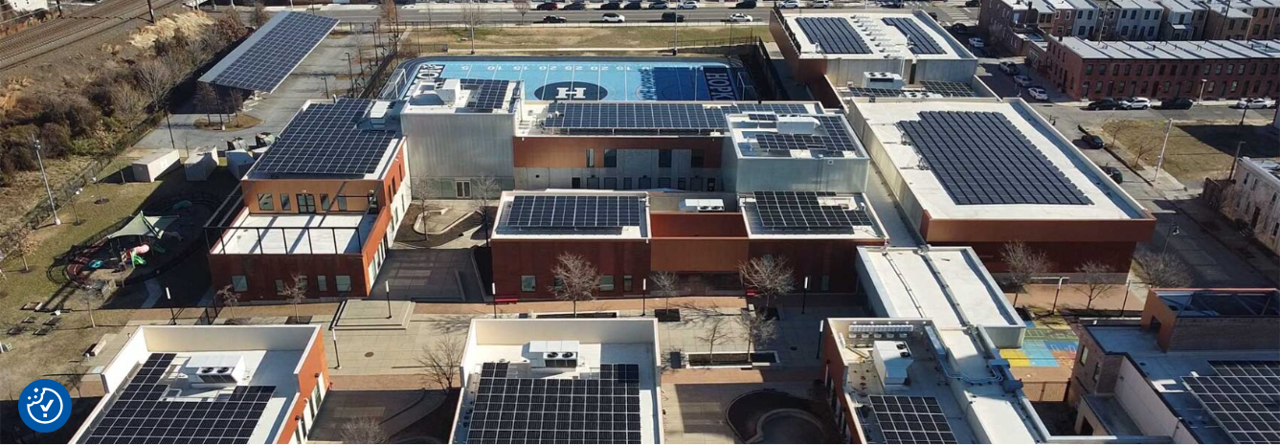
Example Community Power Plant A single school delivers to the community
56

Slide 57
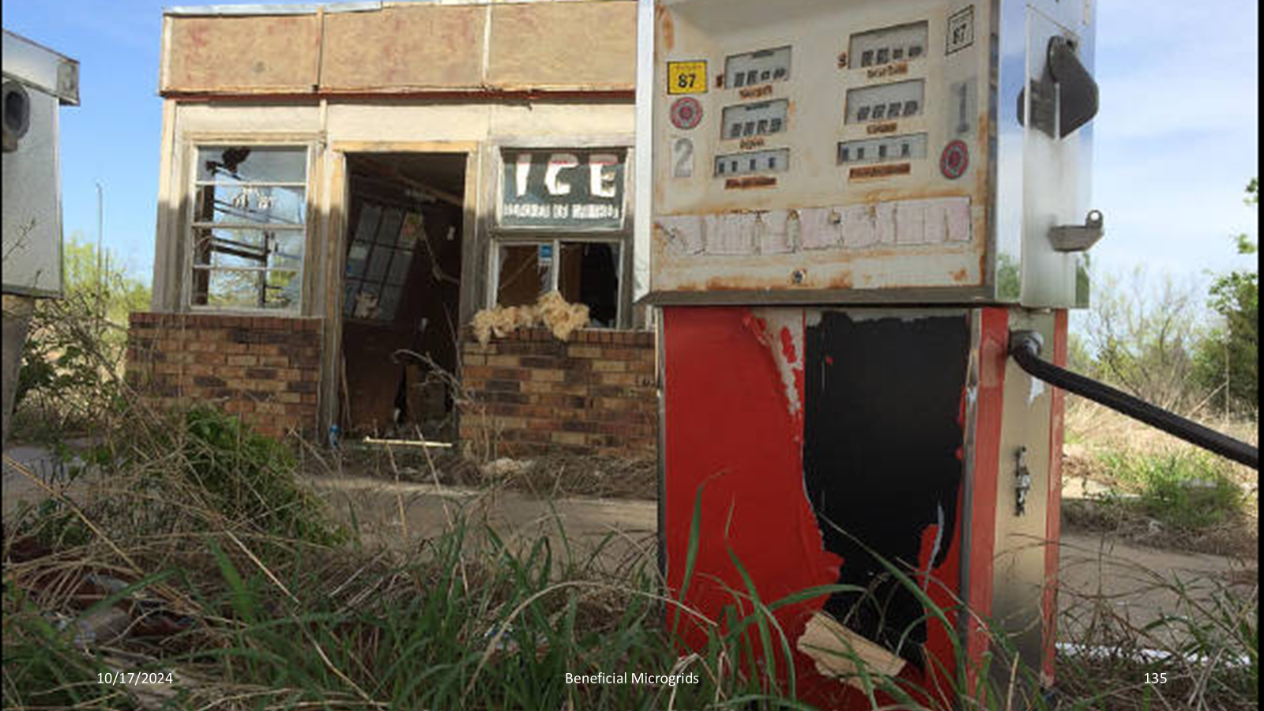
The END of the Old Way
57

Slide 58


Slide 59
Virtual Power Plant References
The grid’s new secret weapon: Your home – pv magazine USA
the role of the household in fighting climate change - Canadian Association for the Club of Rome
Ontario Launches New Energy Efficiency Programs to Save You Money Save on Energy Save on Energy Home Renovation Savings Program Page Enbridge Gas Home Renovation Savings Program Page Manage energy costs for your home Manage energy costs for your business Ontario’s Affordable Energy Future: The Pressing Case for More Power
59

Slide 60
Other References
Tesla Solar Roof Review: Was it Worth It?
source and share power locally, phantom power (base load)
A more distributed model of the grid enables lower energy costs, energy independence, and enhanced local resilience. Location of the DER (batteries or generators or demand response) for distribution-connected generation, storage and controllable loads is vital (areas of gird congestion, fluctuating demand, long term demand growth, aging grid transmission and/or distribution)
60

Slide 61
Other References
The grid is the most complex machine on the planet that most people, including you dear reader, depend on every second of their life. Nuclear makes it more expensive and complex when what is required is improved affordability, lower complexity and greater distribution in our generating capacity. Resilience becomes increasingly desirable as weather systems and wildfires threaten out central facilities and their aging transmission and distribution networks. The benefits of moving the electricity generation right to the demand loads are enormous and more important than financial arguments. Reliability, resilience, availability, safety, flexibility, and security are some terms that come to mind. The terms used by the industry are Distributed Energy Resources, Non-Wired Solutions, Microgrids, Virtual Power Plants, Battery Energy Storage System and Renewable Energy. Modernization of the grid must move away from the old technologies to those proven to be superior.
61

