Slide 1

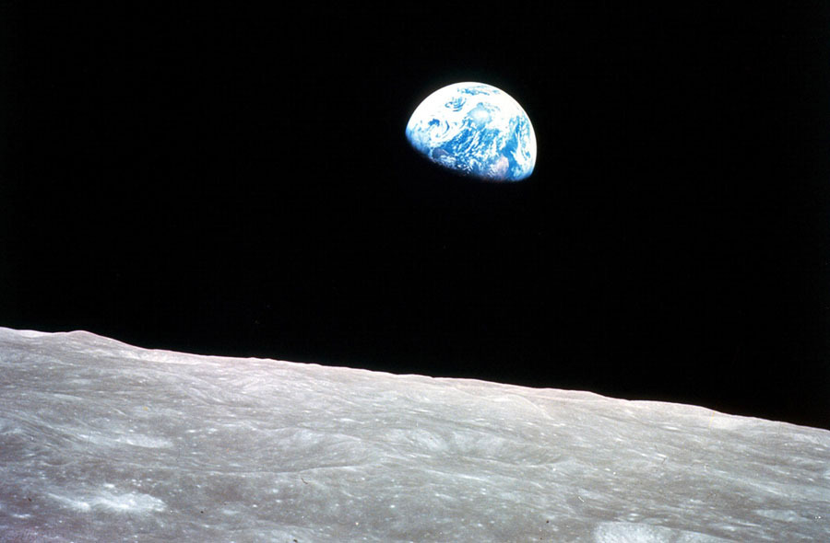


takk
ᑭᓇᓈᐢᑯᒥᑎᐣ !
Nakurmiik!
ありがとうございます
Muchas gracias
!
Thank You!
Merci Beaucoup!
Nakitktam
நன்றி

Slide 2
Why “Double Overshoot?”
!
Systematically Reimage the Human Problematique
AND
Understand Why It is Inherent in MTI Cultures
Ruben Nelson
Foresight Canada
October 30, 2024
CACOR
rubennelson@shaw.ca
+1-403-609-1016

Slide 3

1st Set the Scene

Slide 4
A Systems Perspective on the Problematique
Can it Help?

Slide 5
A Systems Perspective on the Problematique
Can it Help?
“Can we apply a systems perspective to this
which has been described as a poly-crisis and define possible strategic and impactful responses?”

Slide 6
A Systems Perspective on the Problematique
Can it Help?
“Can we apply a systems perspective to this
which has been described as a poly-crisis and define possible strategic and impactful responses?”
Your Darn Tootin’ it can!

Slide 7
My Approach
Sketch a possible CACOR project, which will:
  Apply wise, systemic, integral and reflexive consciousness to the problematique.
  Offer a radically new understanding of our actual problematique_{N}.
  Explain why the problematique as now experienced is inherent in MTI cultures.
  Explain why MTI cultures are blind to the actual problematique_{N}.
  Explain why we must transcend our formation as MTI persons and cultures.
  Offer reliable insights to persons/institutions/communities regarding how to learn to do this.
  Offer a way “to lead the MTI fly out of the Wittgensteinian fly-bottle.”
  Do for CACOR what LtG did for COR.

Slide 8
2nd Guiding Insights

Slide 9
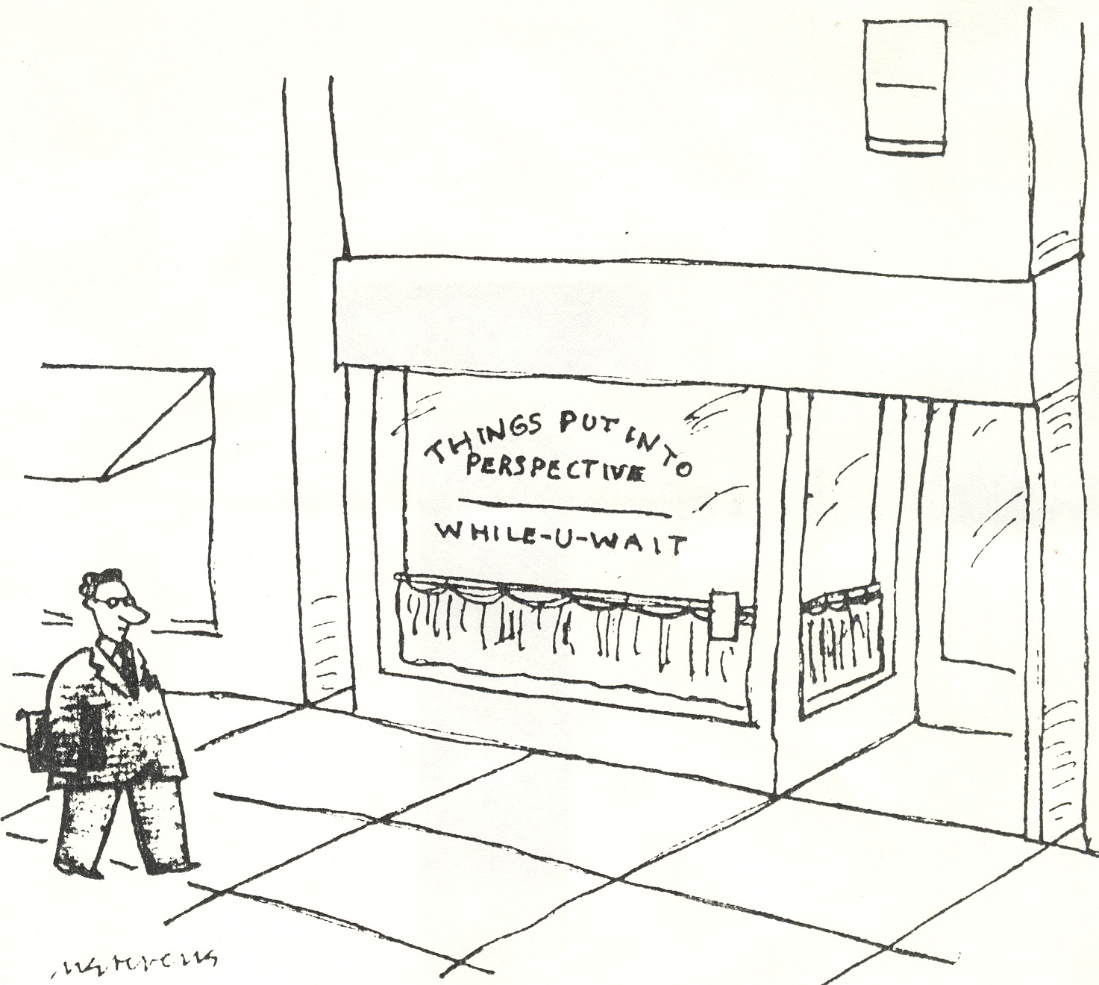
Our Apprehension of Reality Shapes Our Responses to It
“Our perspective on the world determines how we behave in the world.”
Fouts and Jensvold, Probing Human Origins, 2002

Slide 10
Key Notion
In each chapter we also provide examples of how, when done well, successful strategic leadership can transform even the most seriously disadvantageous situations for the better. Yet, when it fails, it can turn likely victory into certain defeat. Leaders, some of whom are politicians in this book, while others are soldiers, must be able to master four major tasks. First, they need comprehensively to grasp the overall strategic situation in a conflict and craft the appropriate strategic approach – in essence, to get the big ideas right. Second, they must communicate those big ideas, the strategy, effectively throughout the breadth and depth of their organization and to all other stakeholders. Third, they need to oversee the implementation of the big ideas, driving the execution of the campaign plan relentlessly and determinedly. Last, they gave to determine how the big ideas must be refined, adapted and augmented, so they can perform the first three tasks again, and again, and again. The statesmen and soldiers who preform these four tasks properly are the exemplars who stand out in these pages. The witness of history demonstrates that exceptional strategic leadership is the one absolute prerequisite for success, but also that it is as rare as a black swan.
General David Petraeus
Andrew Roberta
Conflict: The Evolution of Warfare from 1945 to Ukraine
2023
Leaders… must be able to master four major tasks. First, they need comprehensively to grasp the overall strategic situation in a conflict and craft the appropriate strategic approach – in essence, to get the big ideas right.

Slide 11


MTI CANNOT get the BIG Ideas Right
MTI requires us to be:
Logical
Empirical
Rational
Critical
Reflexive
“Nothing good ever came out of a blind spot.”
Louise Penny
Kingdom of the Blind
2018

Slide 12
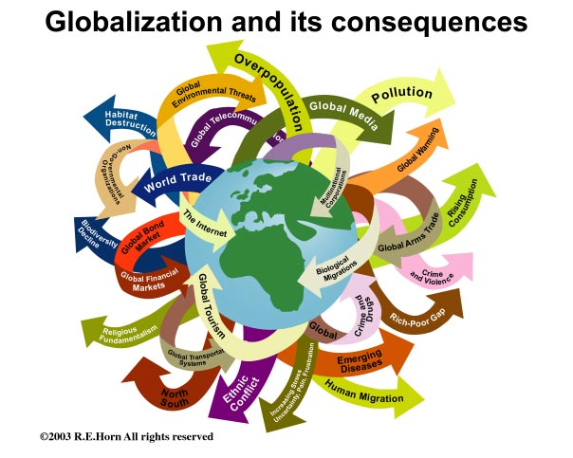
A mess of complex living messes.

Slide 13
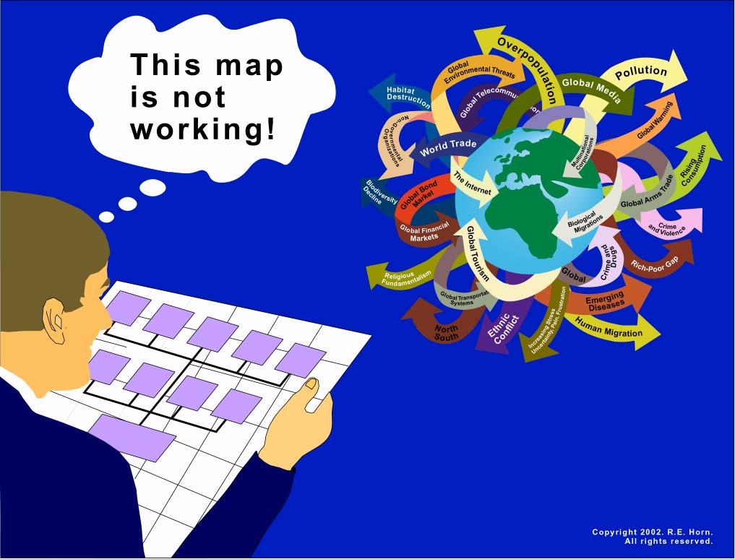
MTI
>
1st Enlightenment insights cannot make reliable sense of living complex emergent realities.

Slide 14
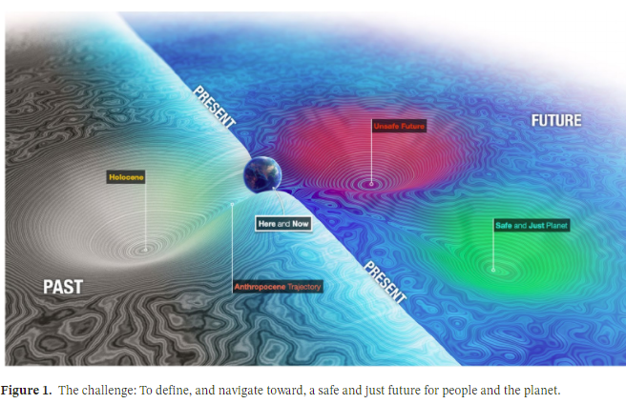
We are in MORE and DEEPER Trouble than we know
MTI

Slide 15
We are in MORE and DEEPER Trouble than we know
Double overshoot:
Ecological and Civilizational.
MTI

Slide 16
We are in MORE and DEEPER Trouble than we know
Double overshoot:
Ecological and Civilizational.
MTI
MTI persons and cultures simply have no long-term future as MTI persons and cultures.

Slide 17
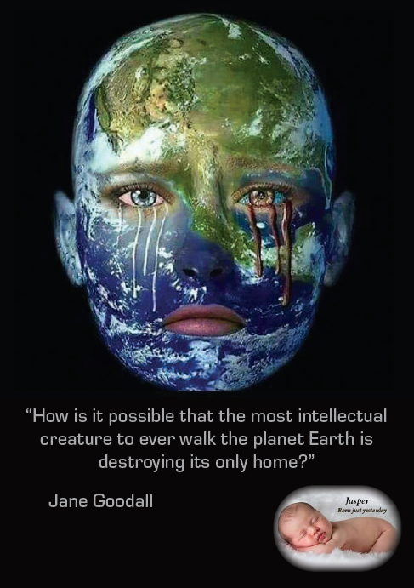
A Question which Still Needs a Sound Answer

Slide 18
Short Answer
The MTI “take” on reality is sufficiently faulty that it cannot nurture a reliable sense of the Earth and life on Earth, including that of humans and other persons.
The key is that MTI cannot require that reflexivity becomes a routine practice of persons and cultures.

Slide 19
A Clue to Our Future
"Scientific knowledge, originally seen to make possible the prediction and manipulation of nature, appears now to be pointing us toward a new relationship with the natural world based on sensitive observation and participation, rather than control."
Brian Goodwin
Complexity Matters:
A Reintroduction to Complexity,
2017

Slide 20
A Clue to Our Future
“I have spent much of the last forty years endeavouring to understand world views other than those we in the West have inherited; and in the last several years I have been particularly concerned with the question of what is involved in the endeavour to (even) understand, and to help others understand, an outlook different from the one that one already has.
One of the conclusions to which I have come is that in order to (even) understand a different view – especially if it be radically different and/or profound, comprehensive, humane – one must oneself become a different sort of person.”
Wilfred Cantwell Smith
ca 1984

Slide 21
Our Work imposed on Ruben’s Whole Systems Governance
Is our knowing as reliable and
thorough as possible?
Our Work space
Work
Plans
Who shall do what, with whom, using what
resources, by when, with what results?
What range of contextual conditions
may emerge? Why? When?
Which programs/structures/people will
achieve which objectives?
What truly strategic challenges
may we face? Why, When?
Our Vision
What objectives must we reach
in the next few years?
What is the best future that we
can co-create with others?
Which design & decision rules shall
guide our pursuit of our goals?
Activities
Mission/
Character
What does this future require of us?
What must we be, aspire to & become?
What resources are we willing to
commit to these initiatives?
Why?
How?
What truly strategic initiatives
could shape our future?
4.
Continuing behaviours that have been successful, long after the conditions that made them successful have evolved into a fundamentally
new state that require new responses.
“Culturally Entrained & Progress Trapped”

Slide 22
If asked I shall elaborate.

Slide 23
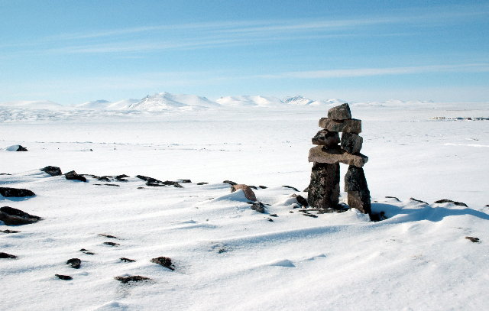
Over to YOU!
Our Future is in Our Hands, Minds, Hearts and Spirits
Thank You!

