Slide 1
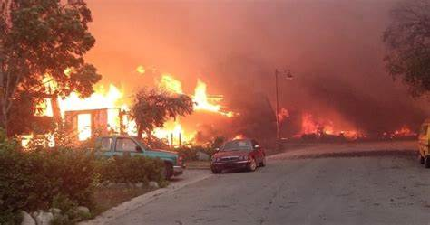
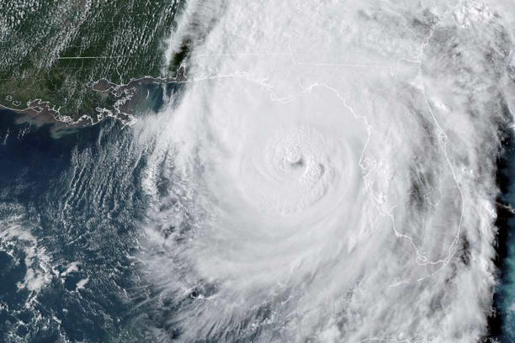
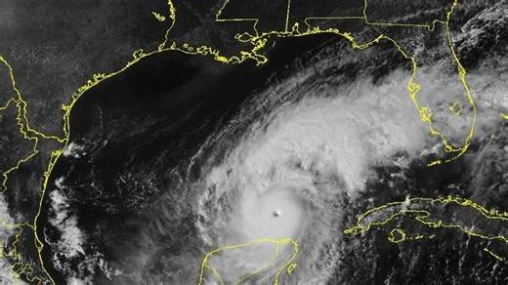
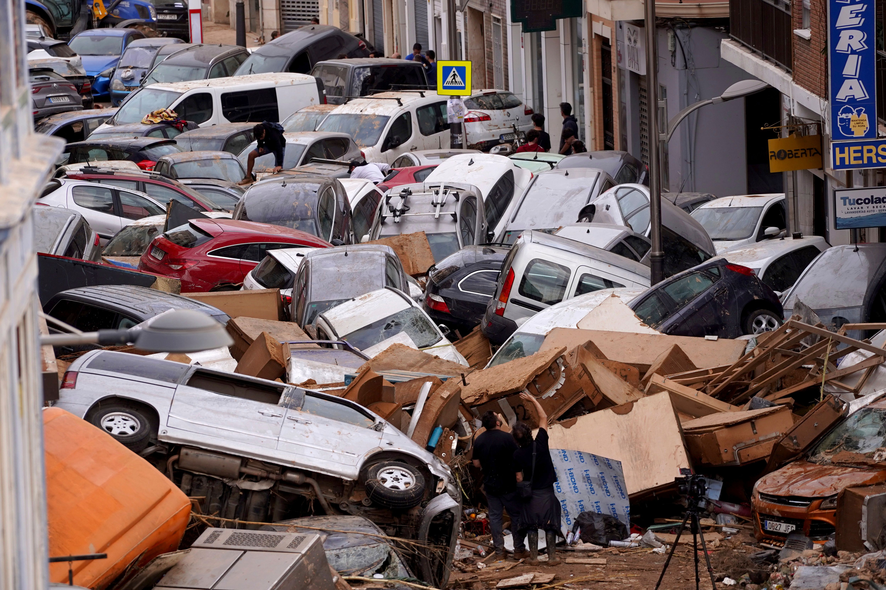
A Practical Way Forward with the Climate Crisis
Presentation to Canadian Association for Club of Rome - November 06, 2024
CACOR
Geoff Strong (geoff.strong45@gmail.com)
Director CACOR, Director PCN, Member CMOS
Most recent severe Impacts
of the Climate Crisis
July 24, 2024 - Jasper Park Wildfire
Sept., 2024 – Hurricane Helene, Florida +
Oct., 2024 – Hurricane Milton, Florida
Oct. 30, 2024 – Rain flooding, Valencia, Spain
Jasper in flames, July 24, 2024
Sept., 2024 – Hurricane Helene
Oct., 2024 – Hurricane Milton
SSTs > 30ºC
SSTs > 30ºC
Oct. 30, 2024 – Valencia, Spain
Notes:
Thank you Bob, and before I go too far forward in this talk, I wish to emphasize that I am not so naive as to think that my suggestion for “A Way Forward” is the only one. There have been many suggestions put forward for how we should be treating the climate crisis, most of which I don’t agree with, but anytime I speak out against a suggestion, I always say why, and suggest an alternative. I implore you to treat my suggestions likewise.
So, we start with this beautiful scene from Cowichan Valley where I live. We are looking north-northeast across Cowichan Lake. But you will also notice something marring the scene, and that is the clear-cut areas on the sides of the mountains. The lake is at about 160 m ASL, where the mountains max out around 1100 m or so. These cleared areas were clear-cut some 40 years before (1980s). Most were not replanted, so with successive large snowpack and spring rains, the soils wash down into the lake and nature cannot readily reclaim the forest. Additionally, the wash-out of mud, particularly along the Cowichan River on the east end, cause all sorts of problems for migratory salmon. I won’t say much more about this in particular, only to add that it is just one example of how humans do not interact well with the environment in sustainable ways.

Slide 2
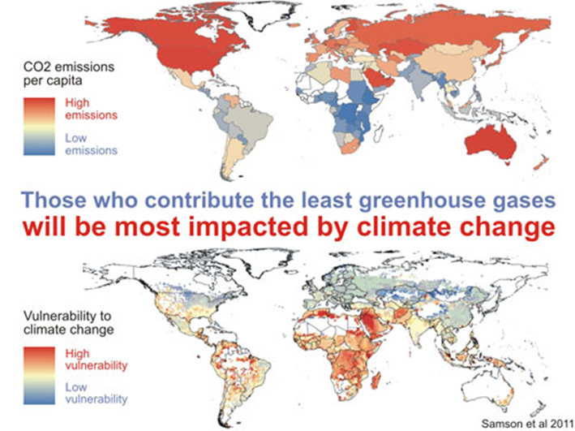
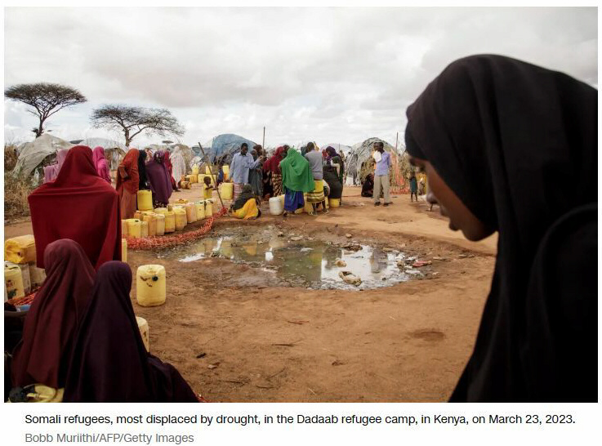
WORST IMPACTS of Climate Crisis – in the Subtropics
(A)
(B)
Notes:
So, NOW to the IMPACTS of the climate crisis, and we’ll just quickly review some examples.
First, this diagram shows on top, areas of ‘high’ emissions, clearly the mid-latitude industrial countries. And least emissions occur over the tropics and subtropics. But the tropics and subtropics, generally 38S to 38N lat., also experience the worst impacts of the crisis.
The picture on the top right shows an area of east central Africa, Ethiopia, where the have edxtreme drlought and loss of arfable water. All these cattle died from no water. The people have given up, and have become ‘climate refugees’ and are headed north, will attempt to get to Europe, or to N.A., Canada being the preferred place to emigrate to, IF they can find transportation. We’ll hear of and see far more climate refugees in future years attempting to just survive.
Most severely hit right now are Somalia in E Africa, and across the Red Sea in Arabia, Yemen. Both suffering very extreme and long-lived drought. The text that accompanied the photo of the young boy in advanced famine, indicated they did not expect him to live another 24 hours.
Then there is ‘ocean acidification’; most atmospheric carbon eventually winds up in the oceans, Mixing CO2 and H2O gives you ‘carbonic acid’, soi the oceans are slowly acidifying. First to go are shellfish, as it softens their shells so they have no defense and die off (all by 2050); fish also affected by softening of their bones, so they too die off, an awful thing when you consider that at least a third of Earth’s population live on seafood.

Slide 3
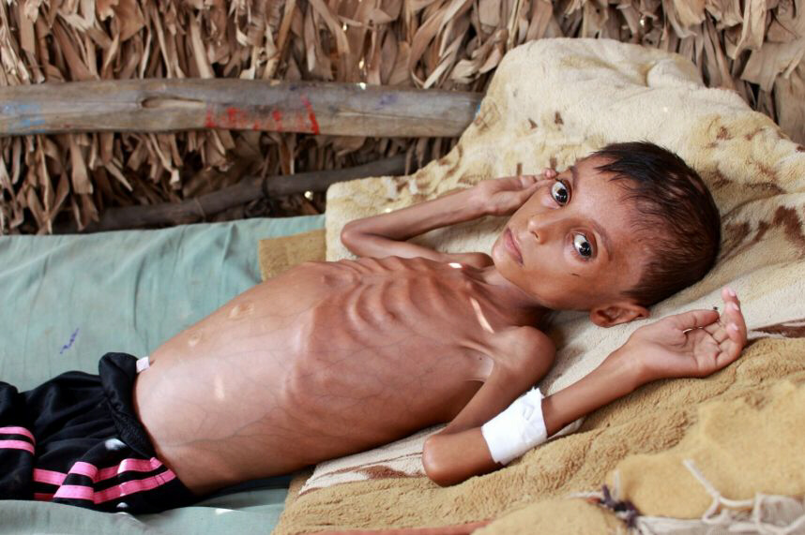
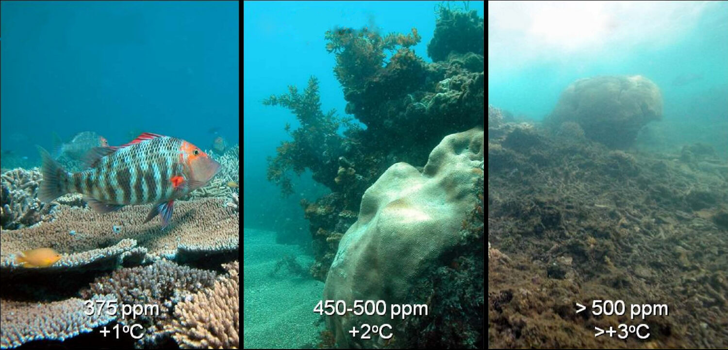
WORST IMPACTS – in the Subtropics (cont’d)
(C)
Yemen, 2021
(D)
Ocean acidification
Corals, Shellfish, and other fish species declining

Slide 4
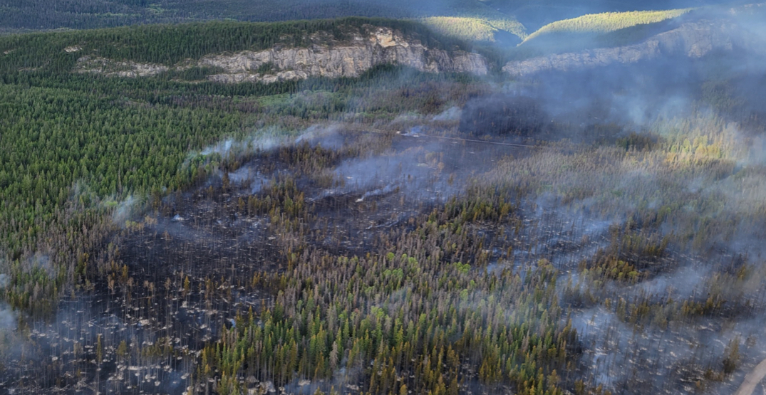
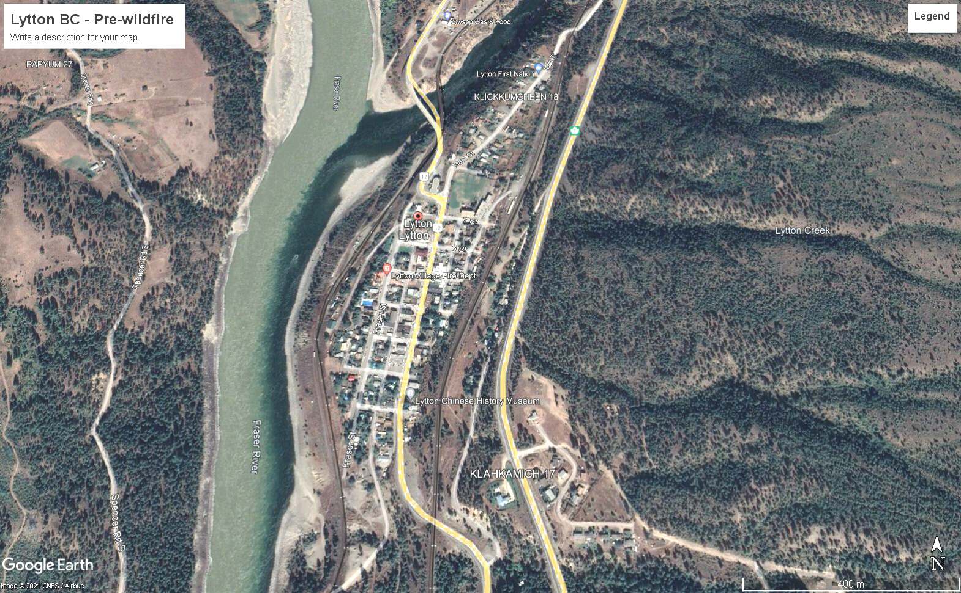
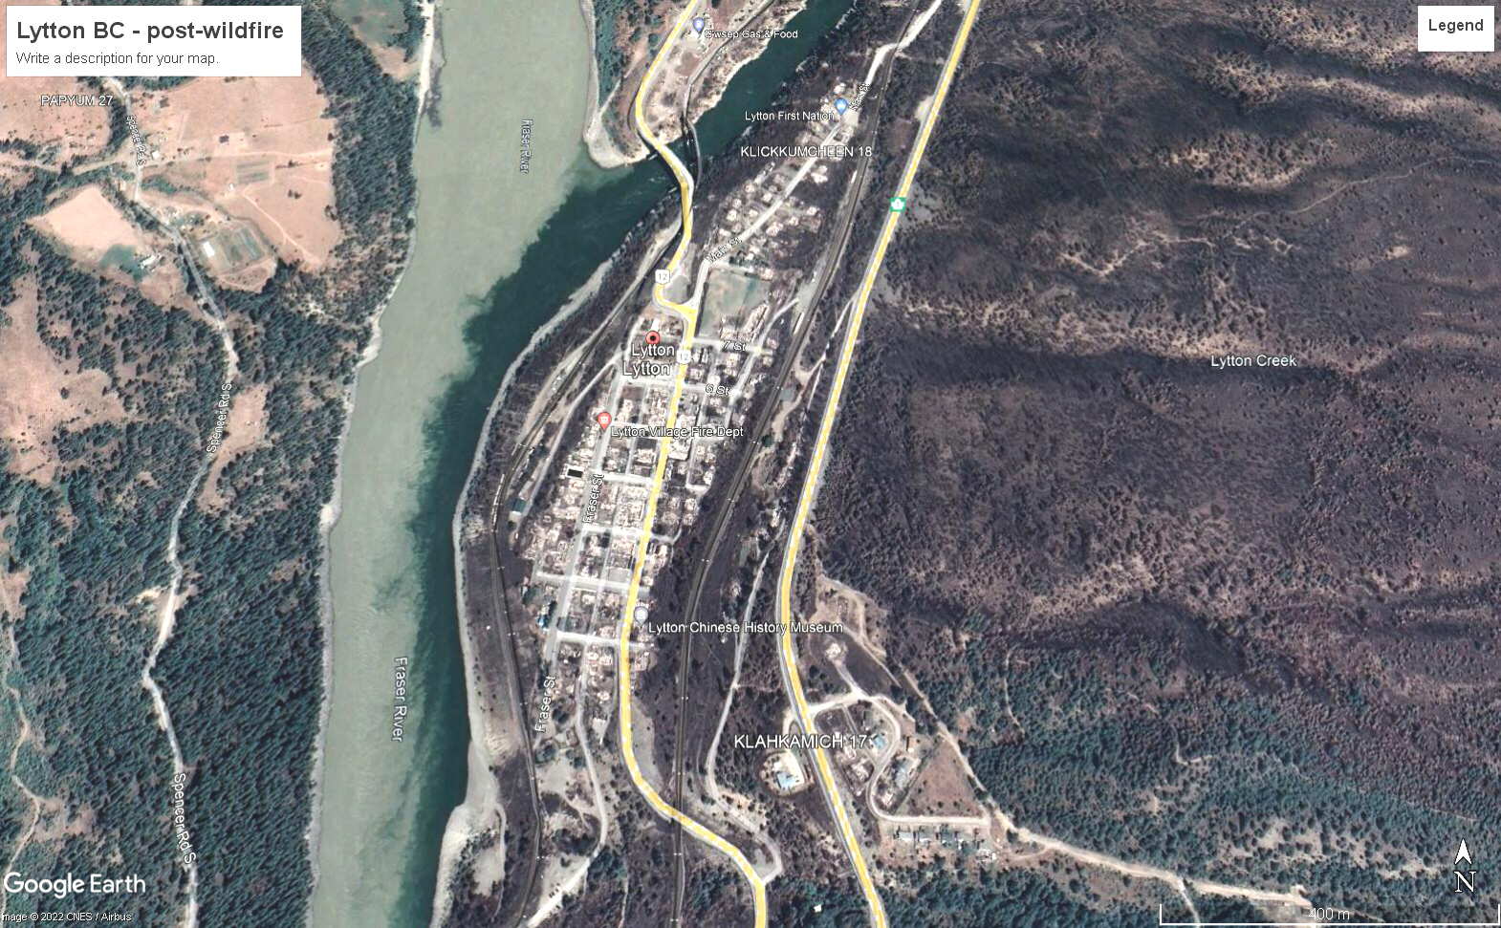
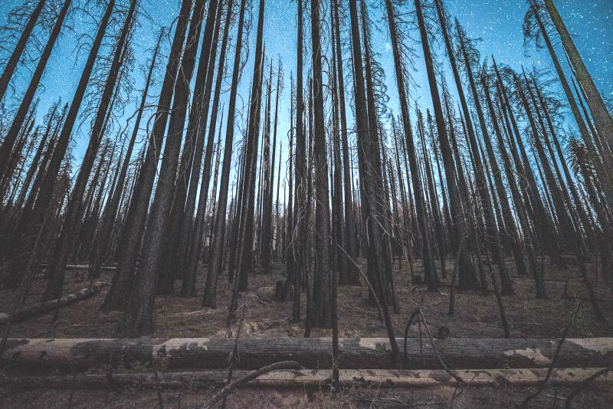
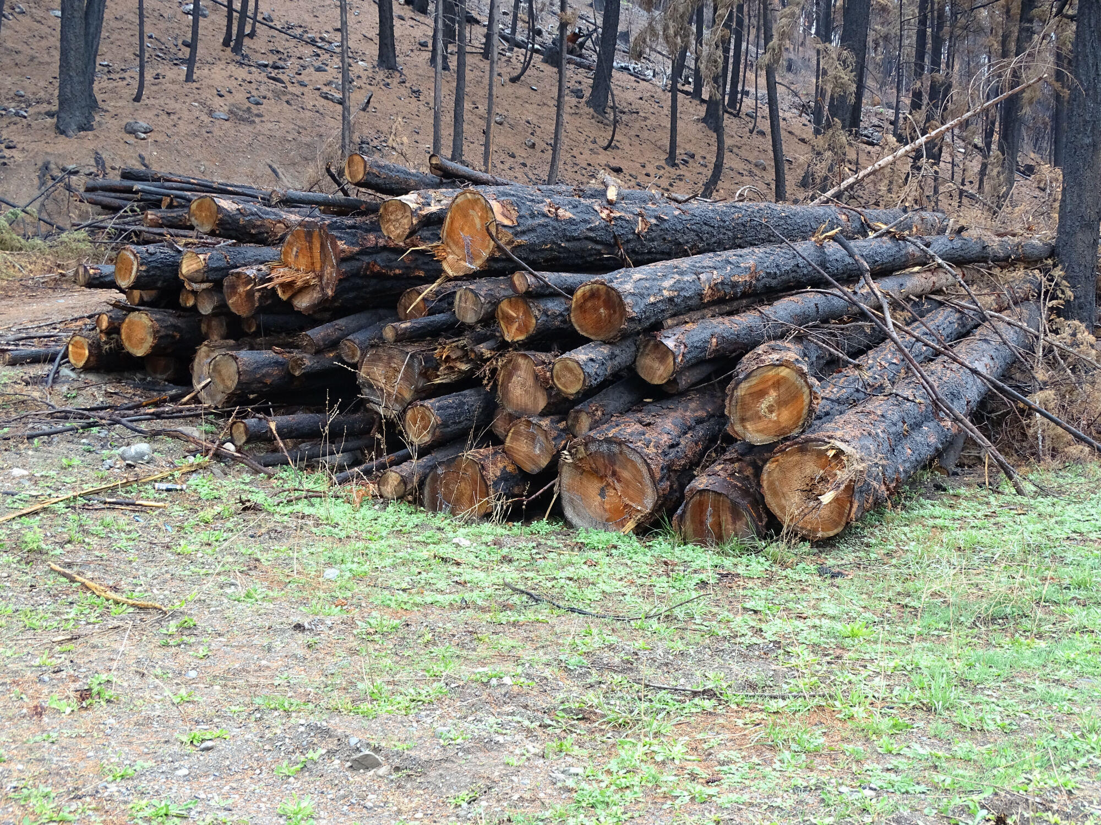
An Aside on Carbon Emissions from Wildfires:
Claims in August, 2023 that carbon emissions from
Canada’s wildfires were 50-100% of total annual
emissions from all other sources.
MY CLAIM: ‘Disinformation’ item that may have come
from either the fossil fuel industry or big government, in an
attempt to deflect attention from the burning of fossil fuels.
Jasper Park Wildfire, July 2024
BEFORE Lytton Wildfire, June 2021
AFTER Lytton Wildfire, June 2021
- Burn areas sporadic (not completely burned)
Tree trunks like these following a forest
fire can probably be harvested instead
of being left to rot while emitting its
carbon back to the atmosphere.
Burned tree trunks from near
Lytton BC, October 2023
Jasper Park burn area

Slide 5
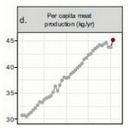
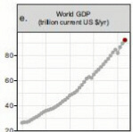
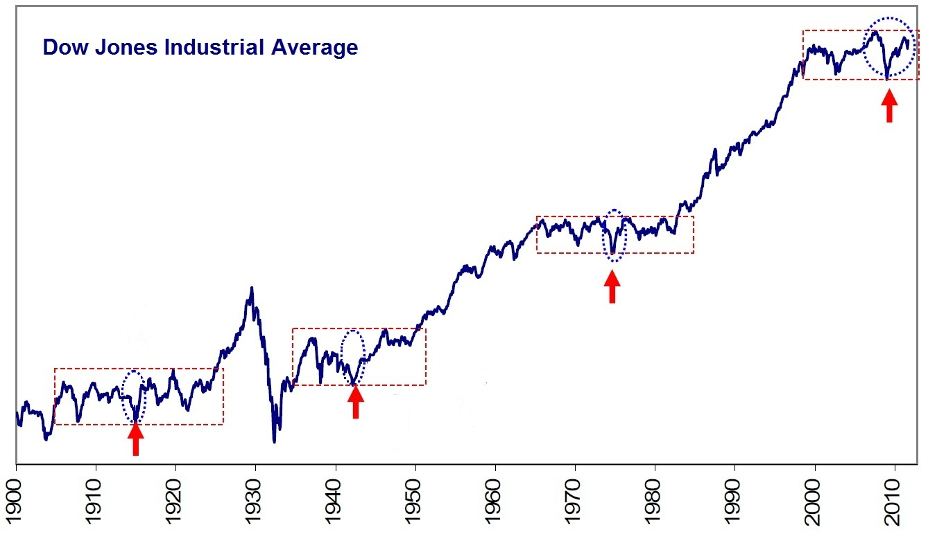
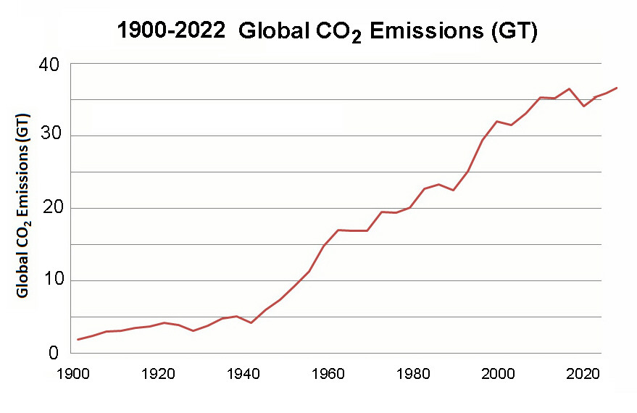
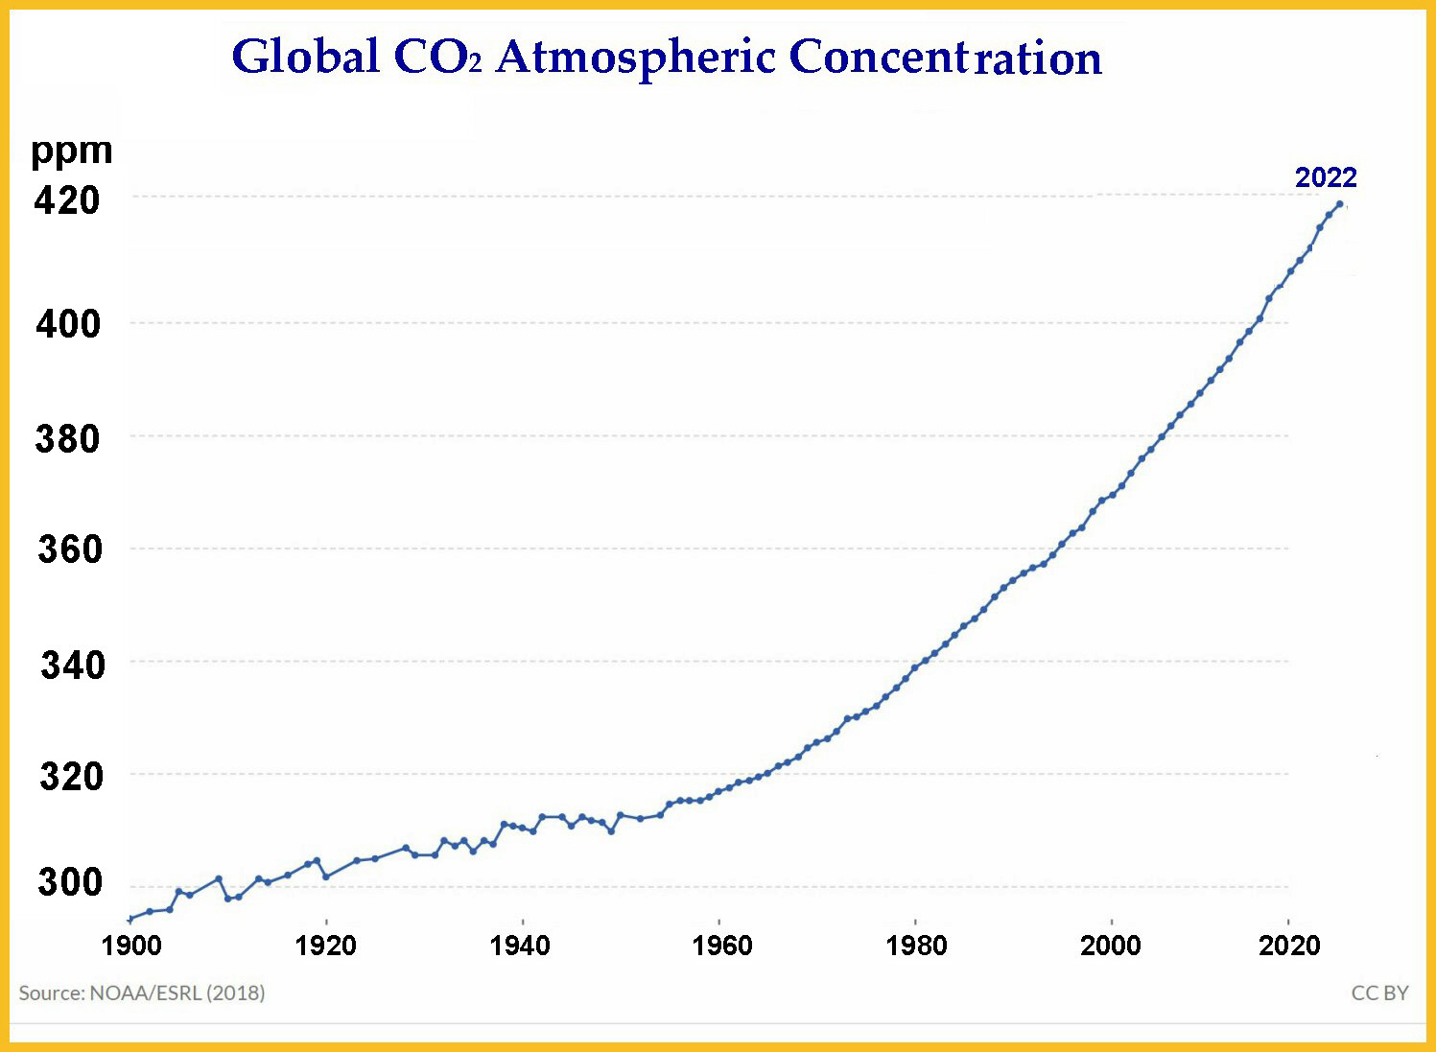
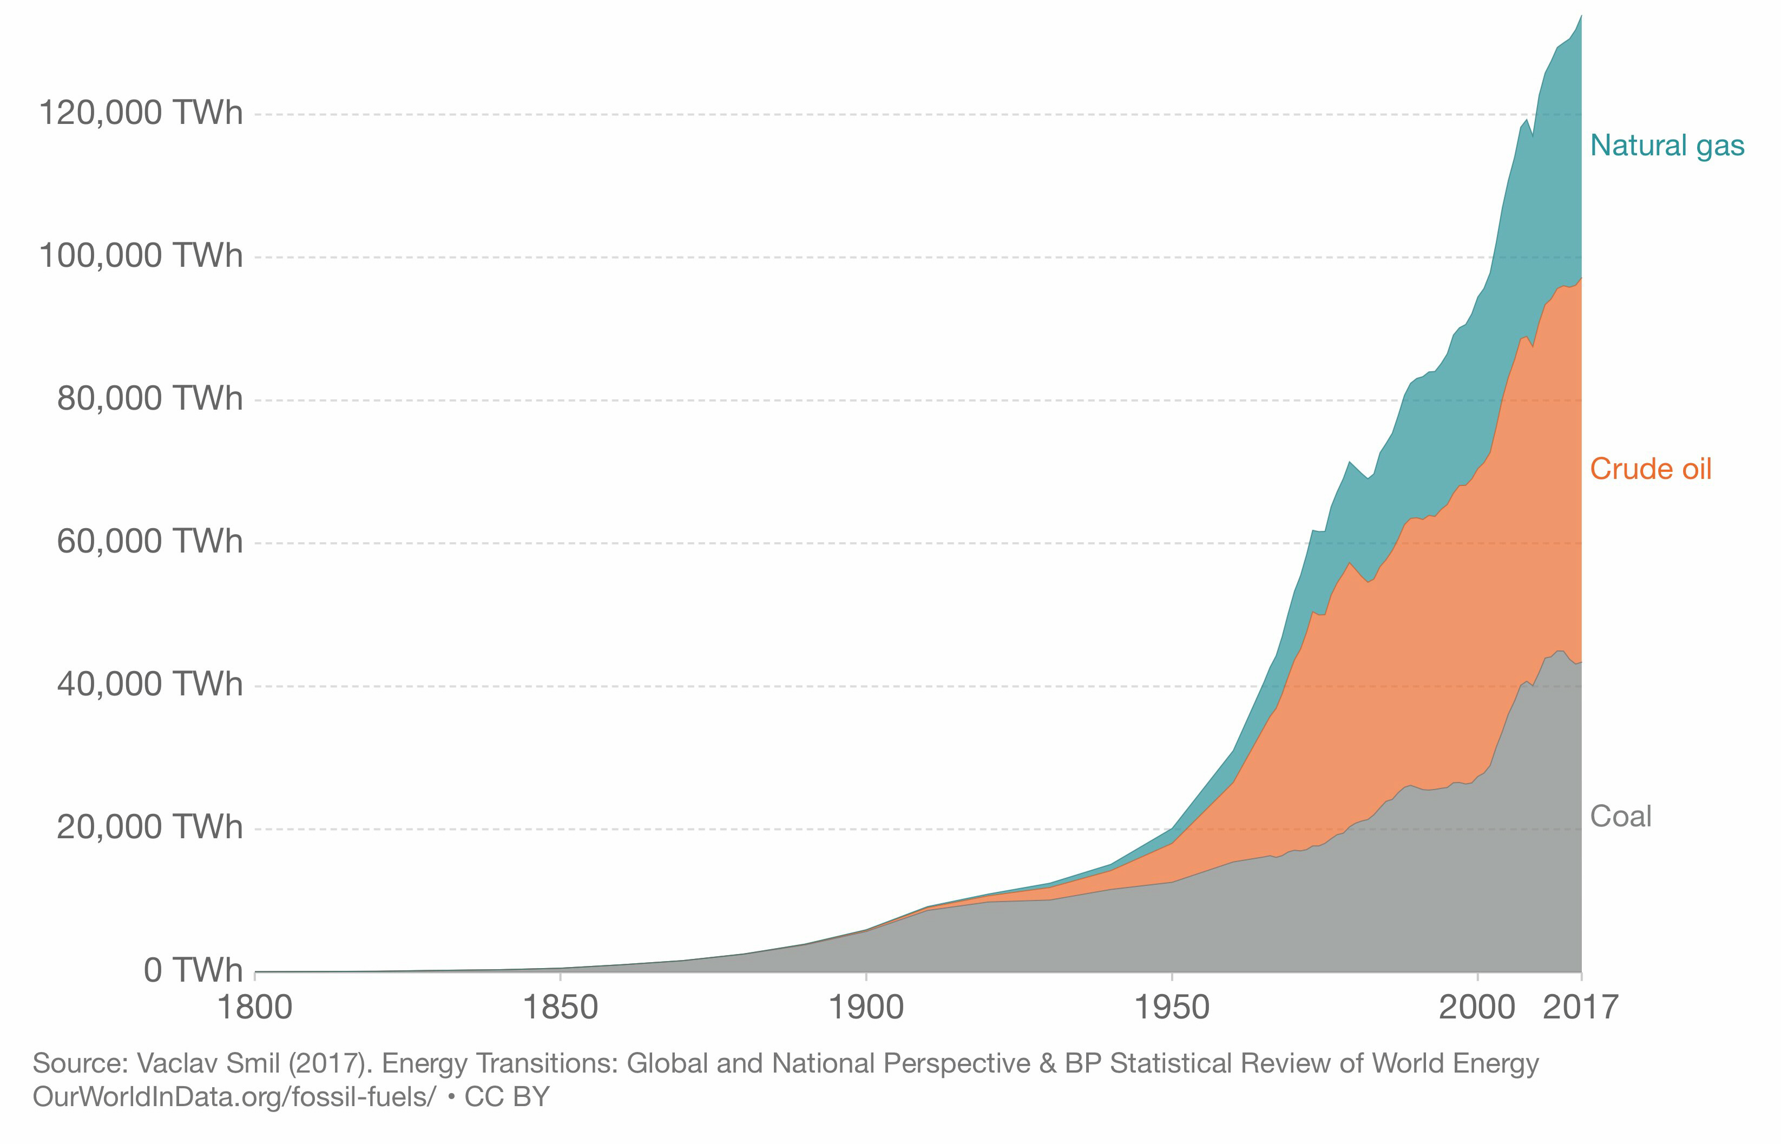
Unlimited Growth
Dow Jones Industrial
AverAGE
Meat Production
Global GDP
Unlimited Growth with Limited Resources
is NOT SUSTAINABLE
Global Fossil Fuel Use

Slide 6
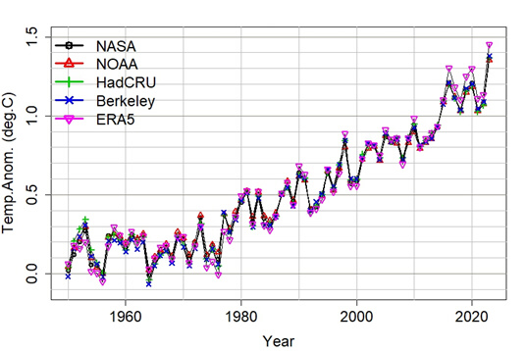
Global Temperature Anomalies to 2023 (based on the 1880-1920 average global temperature)
Possible increase
in the rate of
Warming since 2015
Trust in politicians?
What are the
RISKS humans
face in this?

Slide 7
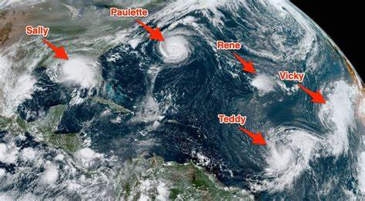
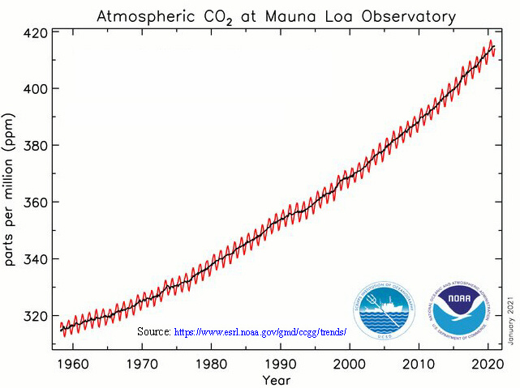
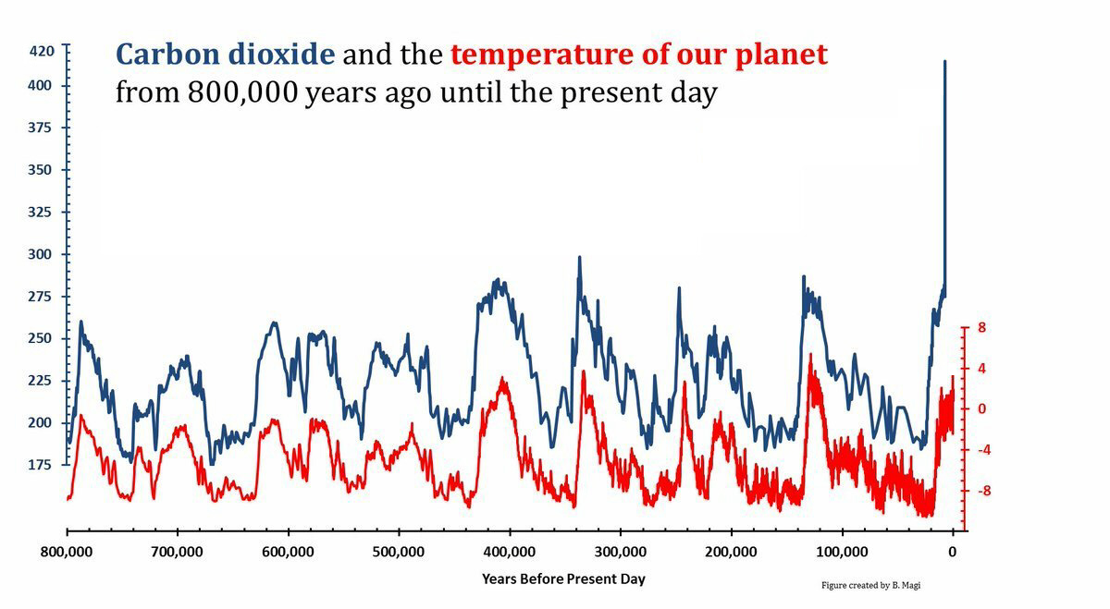
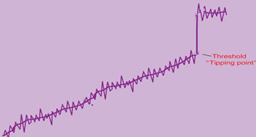
World Economic Forum Annual Meeting
– Davos, Jan., 2024
Identified 3 Major Climate Risks we face:
1) Extreme Weather Events
– major winter storms, flooding events, tornadic thunderstorms, Category-4/5 hurricanes – all occurring more frequently in recent years. The life cycle of all these storms occurs in dynamic equilibrium.
Five tropical storms simultaneous , 2020
Dynamic Equilibrium – where rate of gain = rate of loss,
system returns to a stable condition.
Dynamic Equilibrium
2) Critical Changes to Earth Systems
– tipping point in the climate,
where the climate system undergoes permanent change.
Can occur when positive feedbacks occur simultaneously.
Metastable Equilibrium
Nov 1, 2024 – 424.1 ppm
Nov 1, 2023 – 418.8 ppm
Metastable Equilibrium - where the rate of gain > rate of loss.
System reaches a threshold or a tipping point*, can no longer maintain
its character, and lurches to some new operational level. E.G., Volcano.
3) Biodiversity Loss

Slide 8
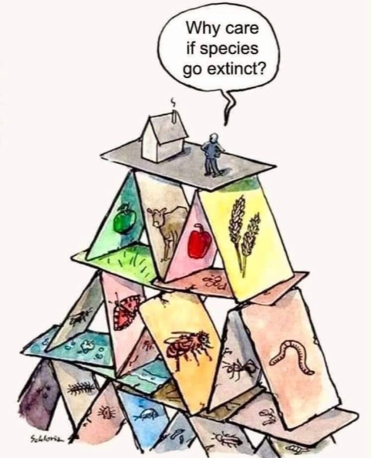
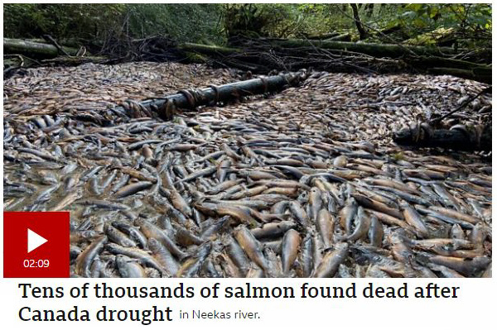
3) Biodiversity Loss - Biodiversity is declining rapidly, with almost a
70% decline in populations of mammals, birds,
fish, reptiles, and amphibians since 1970.
. . . during 2021 Heat Dome over BC
in Neekas River, central BC coast.
Because idiot, we’re at the top of the food chain!

Slide 9
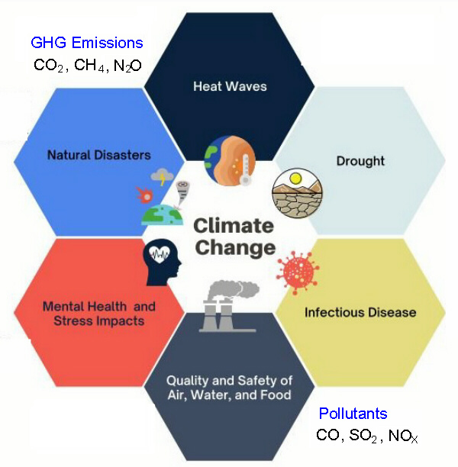
A 4th Major Climate Risk
that the Economic Forum
DID NOT Specifically Identify
Health Impacts
of
Climate Change
Various sources, including WHO
indicate > 8 million people die
annually from fossil fuel pollutants.
*
* Wildfires – which also release ‘arsenic’ into air and water; also tiny particles, PM2.5

Slide 10
We are now in a WAR against climate change,
AND against fossil fuels.
Fossil fuels, wittingly or not, have a second front,
a war against nature.
We need to unite with nature to fight the climate crisis.
So, what is Canada doing to help
fight the Climate Crisis?
What’s the plan?

Slide 11
Canada’s Climate Plan – some important parts
Plant 2 billion new trees
2) Carbon tax
3) Carbon pricing
The Plan has one major flaw.
Focus on continued support for fossil fuels
well past 2050, while it still claims to be
reducing carbon emissions.
- Contradiction!
Carbon pricing
4) Cap and Trade
5) Carbon Capture and Storage (CCS➔CCU)
Items 1-5 won’t do anything substantial to counter carbon emissions in the time we have left before our climate reaches a tipping point (likely 15 years or less – after 2ºC warming).
Details published at: https://bulletin.cmos.ca/a-way-forward-on-the-climate-crisis/
- Also editorials:
https://www.hilltimes.com/story/2024/05/15/why-common-climate-mitigation-efforts-are-not-solutions-to-the-climate-crisis/421897/
https://www.hilltimes.com/story/2024/05/22/the-way-forward-on-the-climate-crisis/422550/
At The Hill Times, search “STRONG JAGT”
Please consult these articles for the details – however, I will say something more about Carbon Pricing (in next slide)
One Useful Item in the Climate Plan:
6) All new vehicles sold in Canada by 2035 must be full electric (EVs) √

Slide 12
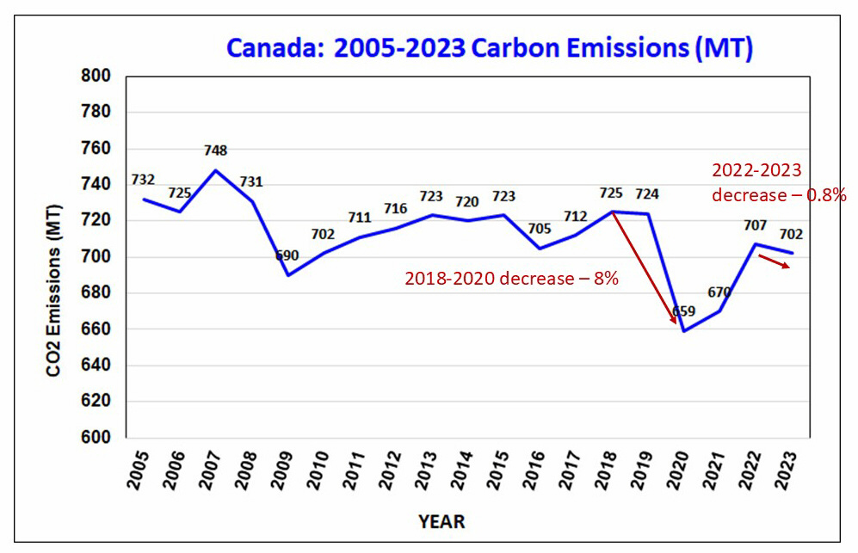
3) Carbon Pricing - Industry and businesses are given a target maximum for carbon emissions. If they exceed their
target, they can buy carbon credits from someone downstream who takes responsibility (passes
the buck). Includes carbon tax.
Government’s Claims:
2018-2020 – 9% reduction*
2018-2021 – 6% reduction
2018-2022 – 2.5% reduction
2022-2023 – 0.8% reduction!
* 2020 emissions were down because
industries shut down for 1-3 months during
COVID and did not regain full production
until 2021.
Government is cherry-picking the data!
- Deliberate deception!
Industry Shutdowns
in 2020 due to COVID
In Sept. 2024, the Canadian Climate
Institute reported that “Canada’s
emissions were cut by 0.8 per cent in 2023 . . . we see policy starting to work.”
https://www.msn.com/en-ca/news/canada/canadas-emissions-dropped-slightly-last-year-with-climate-wins-offset-by-oil-and-gas/ar-A1qPey0?ocid=BingNewsSerp
In actual fact, the decrease, 2022-23
was < 0.1%, well within the range of
errors for these data (5 ÷ 707).
Bottom Line: Carbon pricing is NOT working as they claim, and is unlikely to result in any significant reduction in carbon emissions.

Slide 13
4) ‘Cap and Trade’
37.6 GT
5) Carbon Capture and Storage (CCS):
2023
23 (20-30) operational CCS facilities globally
➔ each year since 2008 they claim that 100s more are
under construction.
Most (if not all) are constructed primarily with government
grants (Canada & U.S.) but are owned, operated, and
reported by the fossil fuel industry (with little or no
government oversight).
Most claim they can increase carbon capture to 1 million tonnes/yr.
Most pipe the liquified CO₂ away to pump beneath oil/gas fields
to improve their efficiency.
In other words, CCS facilities are really CCU (utilization).
1.3% increase,
2022-2023
Assume they do capture 1 million tonnes/year. - Global carbon emissions of 40 GT (40,000,000,000 tonnes).
Number of CCS facilities required to counter global carbon emissions = 40,000,000,000 tonnes ÷ 1 million tonnes
= 40,000 facilities to counter global emissions! (or 4,000 to counter 10% of emissions)

Slide 14
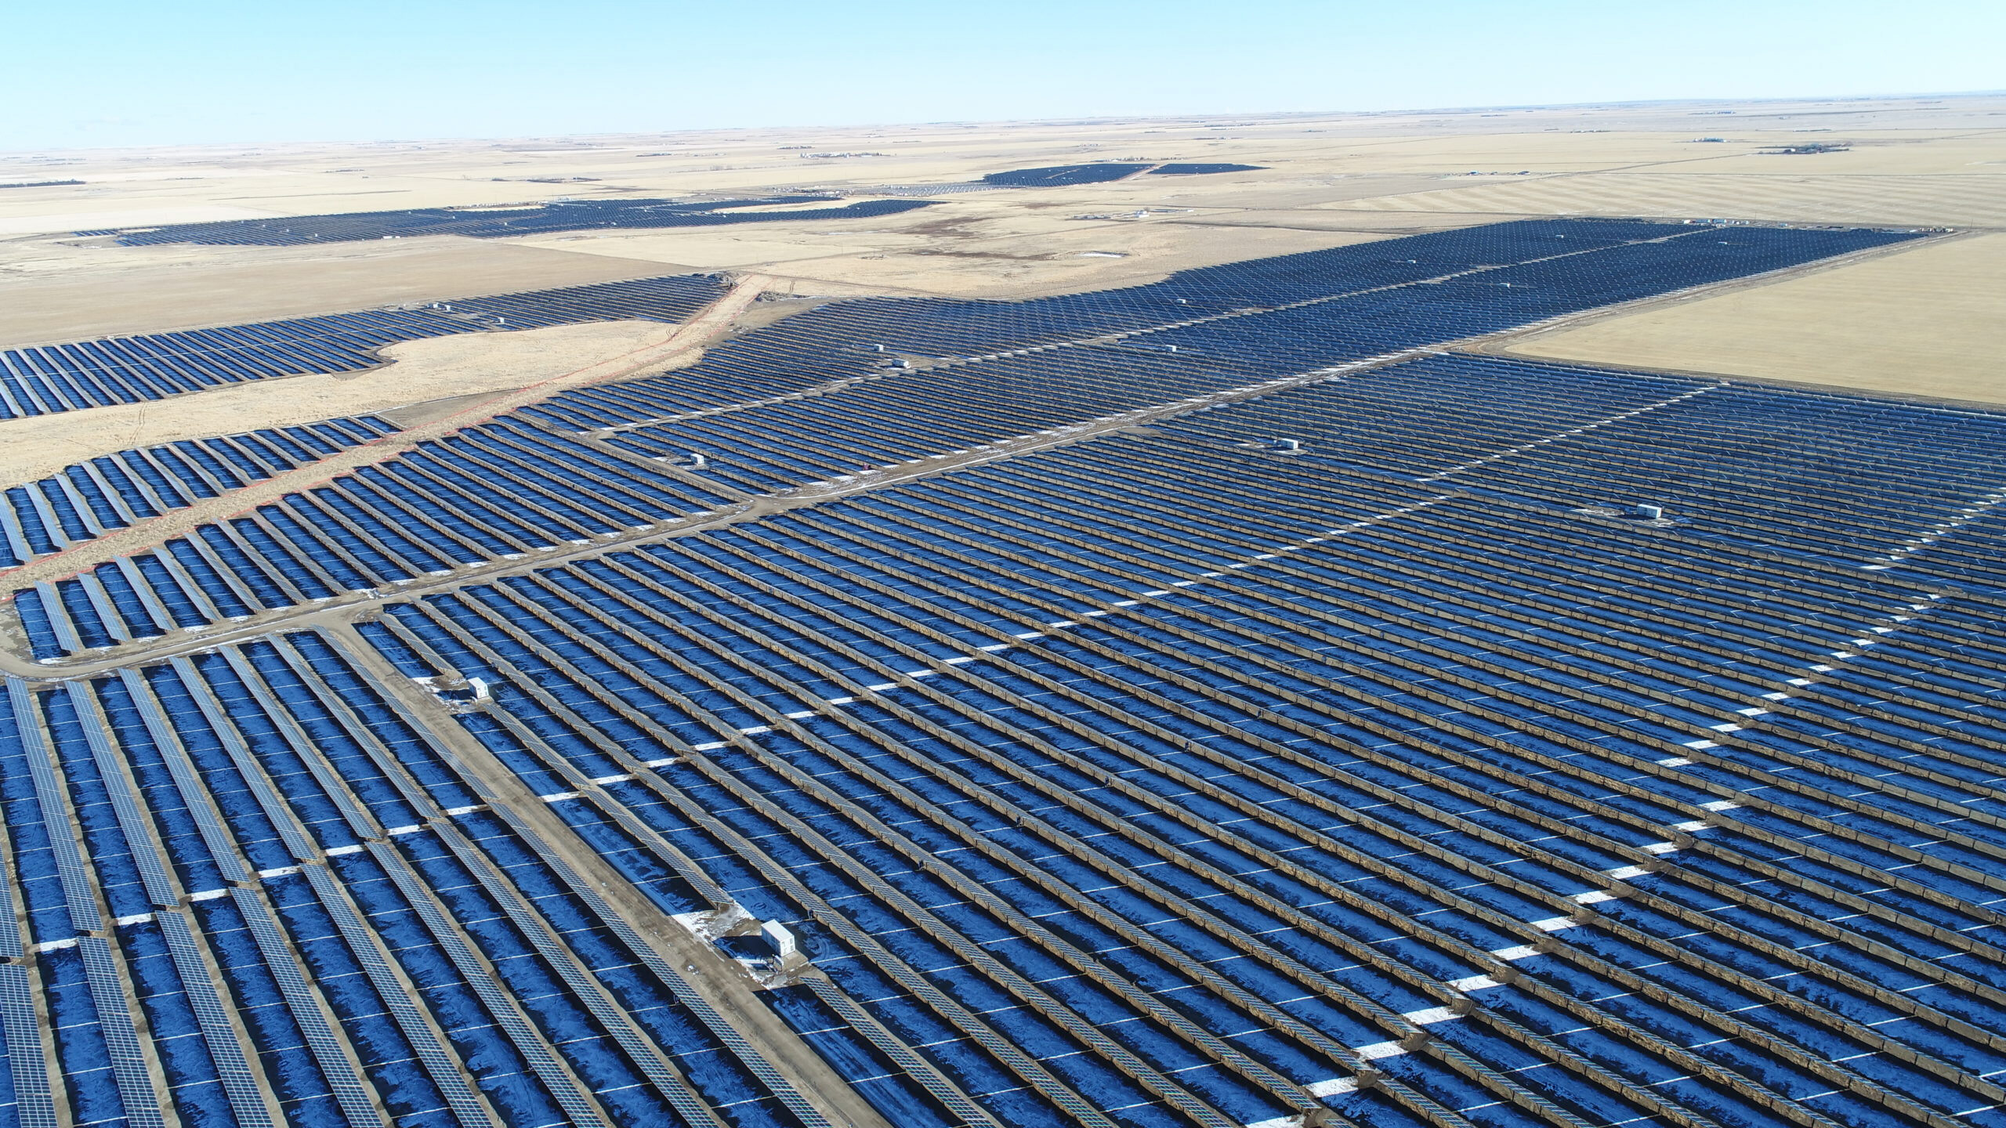
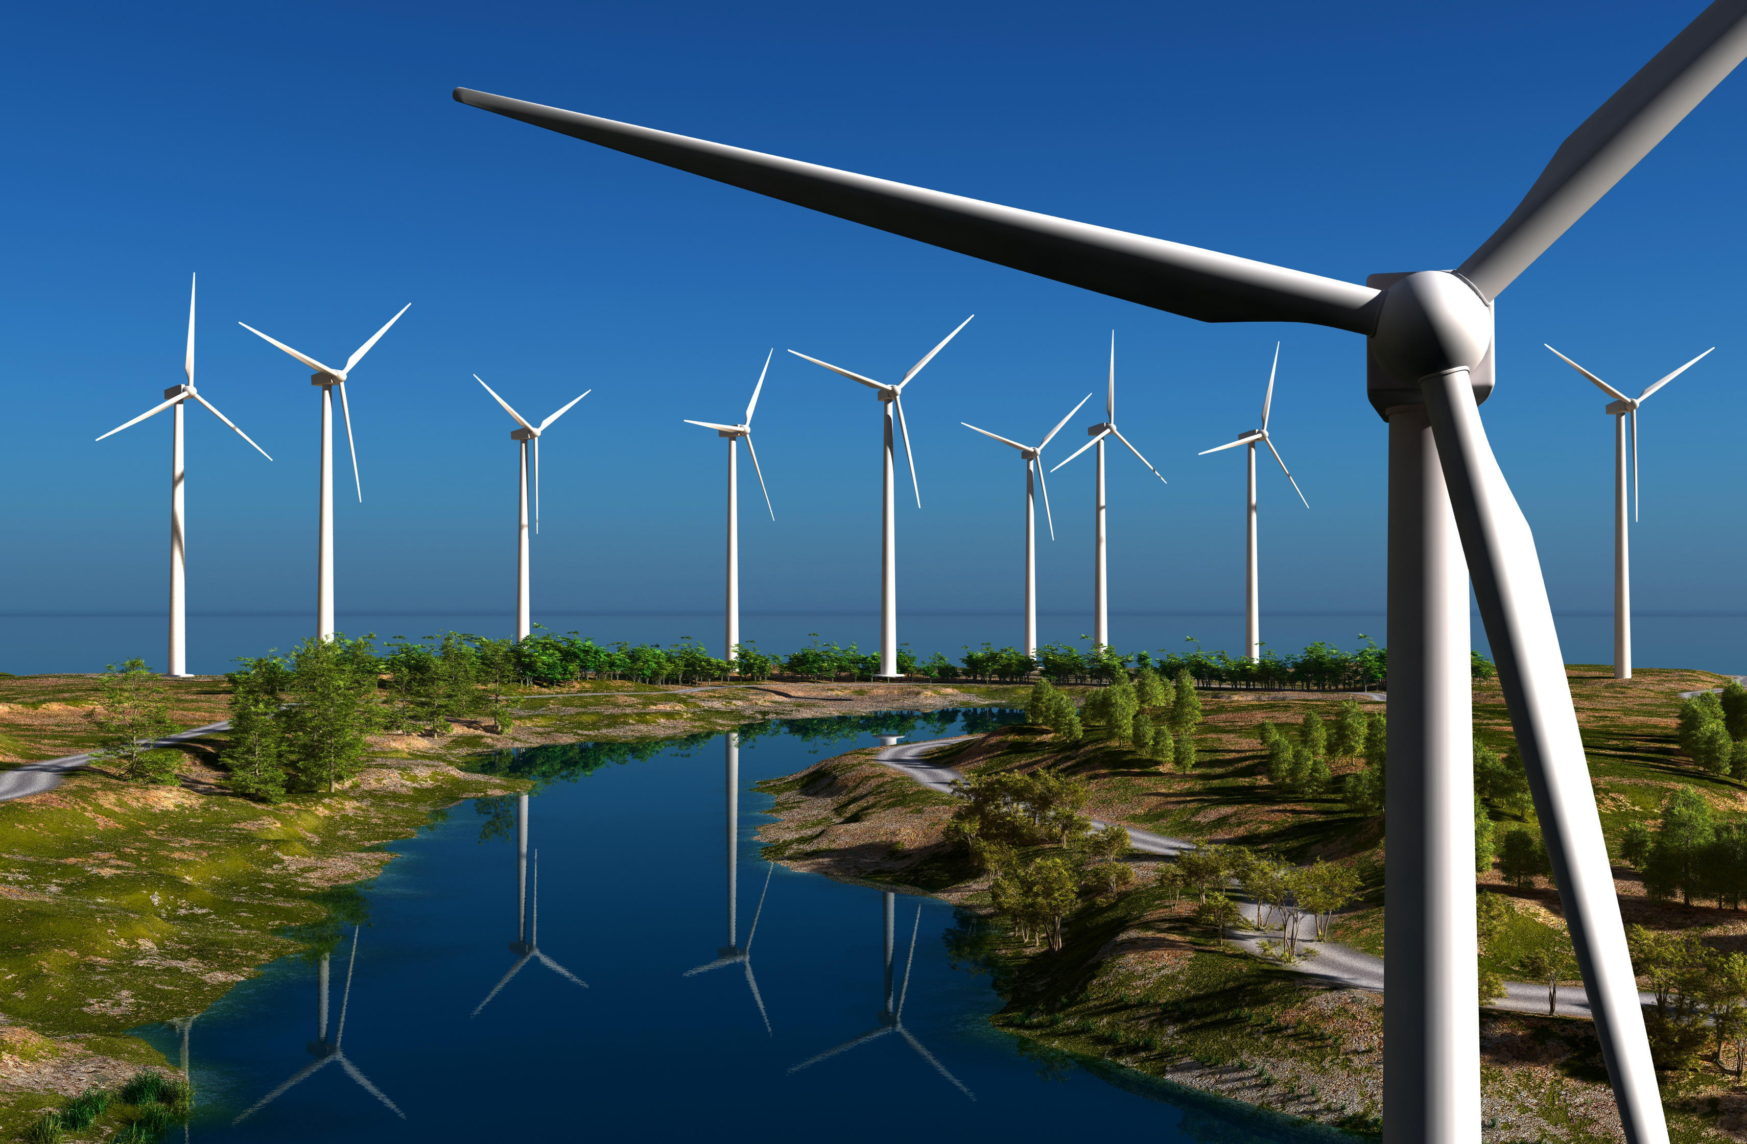
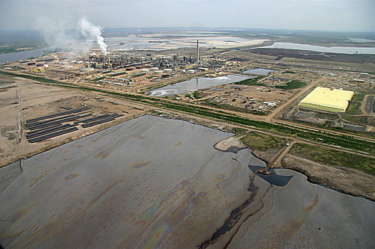
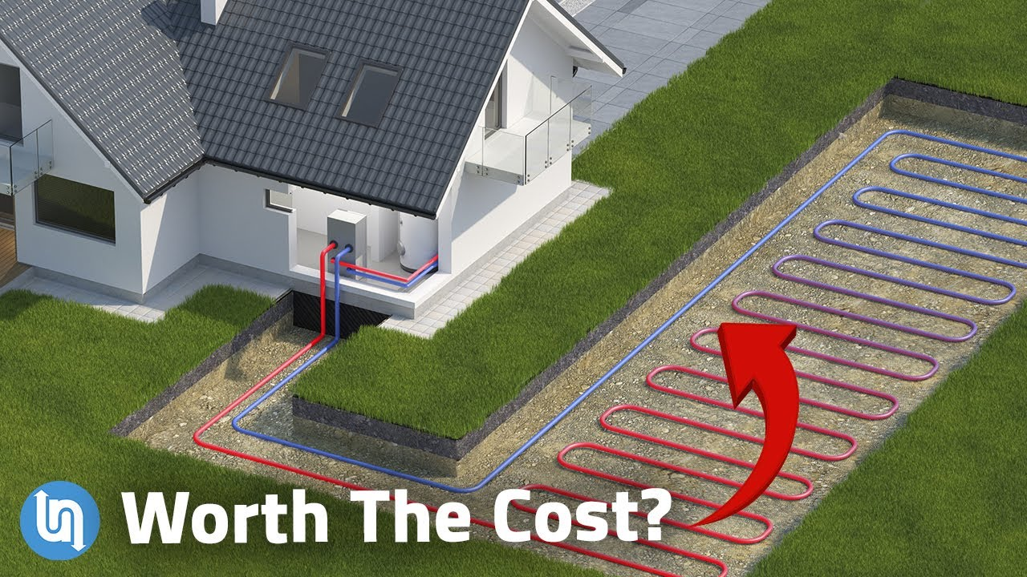
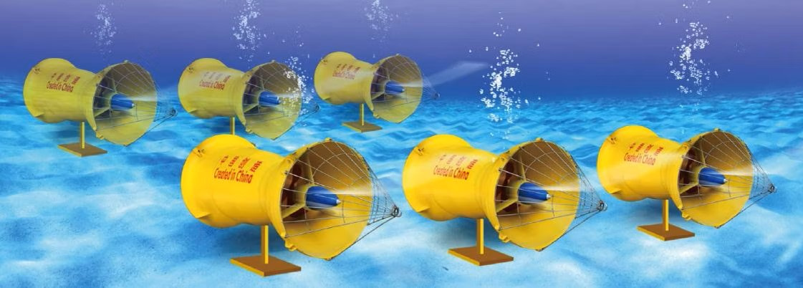
A Way Forward on the Climate Crisis
Renewable clean energy to replace 90-95% of fossil fuels over the next 15 years!
Renewable Energy – solar, wind, geothermal, hydroelectricity, and tidal/wave energy.
ALL are sourced from the sun, the energy is FREE; we just have to harness it, convert to electricity.
NO new technology development is necessary – all have been in use for 100s of years!
Solar farm Alberta
Wind farm
Fort McMurray Oil Sands
Not esthetically pleasing?
Home-sized Geothermal
Small ‘run-of-river’ Hydroelectric turbines (8 kW)

Slide 15
How should a National Policy on Renewable Energy Proceed?
Fossil Fuels are a huge Monopoly
Fossil fuels directly or indirectly swamp
much of the Earth’s resources.
Fossil fuels release carbon emissions when
burned, consisting of GHGs and pollutants
(CO, SO₂, NO_{X}), which warms the atmosphere
while poisoning every living creature on Earth.
FF
(Resources)
(Resources)
(Fossil Fuels)
Worse, if left unchecked, our climate could reach
a ‘tipping point’ within 15 years, after which it would
warm more quickly to a stable level (~ 5 ºC – some
say up to 10 ºC), and we could no longer reverse the
process.

Slide 16
We are now in a War against climate change and fossil fuels (FFs)
FF
RE
(Renewables)
(Resources)
(Fossil Fuels)
Message: Renewables could not survive an open
war with fossil fuels because they have
far more money and power.
Question: How have small armies survived wars against much stronger opponents?
Answer: They can do this if they find a way to ‘flank’ their opponent, sending forces around their back to
attack from front and rear simultaneously.

Slide 17
Small-scale Renewable Microgrids (for individuals) or Mesogrids (at municipal levels)
How can we apply this ‘flanking’
tactic against fossil fuels . . .
RE
RE
((mesogrid)
Flank the enemy with mesogrids.
Join to the major grid and/or
other mesogrids (mutual security).
Encourage small industries to
switch to electric energy.
Draw resources away from fossil fuels.
Market forces take over.
Fossil fuel Demand shrinks.
Fossil fuels reduce Supply.
carbon emissions are reduced.
RE
RE
FF
(Fossil Fuels)
(Resources)
RE
RE
RE
RE
((mesogrid)
In other words, Think global, Act local !

Slide 18
What should be the roles of Federal/Provincial Governments? (should be at):
- Federal and provincial governments should stay at arms length.
Needs government leadership to –
- Stop all subsidies to fossil fuels; fully embrace renewable clean energy.
- Provide subsidies to small businesses or public groups developing mesogrids.
- Work with provincial governments to upgrade major electric grids – West-East rather than N-S.
- Encourage industries to convert to electricity from fossil
fuels (much cheaper, less maintenance).
- Ensure cross-training courses be arranged for workers
switching from FF jobs into Renewables.
Other Advantages of Mesogrids of Renewables:
Each mesogrid can be operated independently, with its own battery storage, or linked with others.
It is trifling easy to expand a mesogrid, simply adding more solar or wind, with no disruption in energy.
With mesogrids, less energy loss over small distances, depending on the voltage (high voltage, less loss)

Slide 19
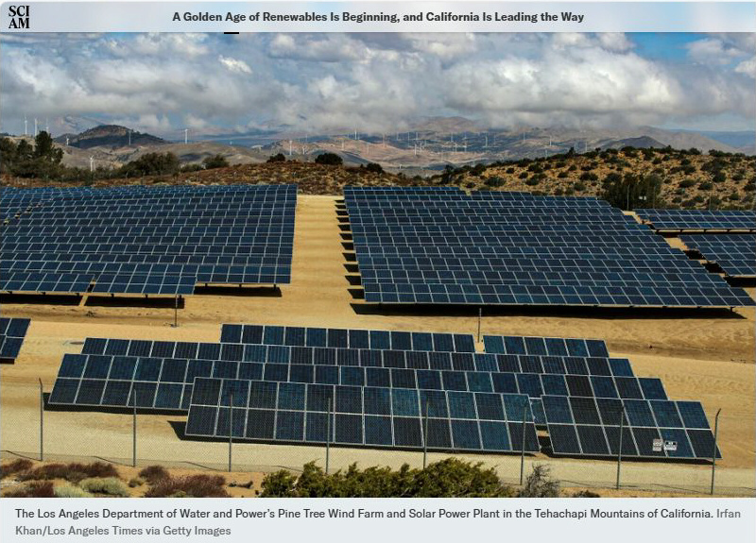
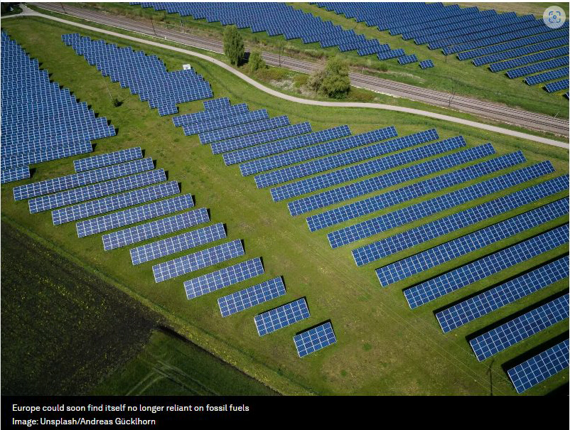
Regions with Rapid Conversion to
Renewable Energy
California
California – 40% retail energy is solar, wind, and geothermal.
– state is now 100% renewable on grid every other day.
– LA pledges 100% renewable energy by 2035.
Texas – 1st in U.S. in wind power, 2nd in battery storage, 3rd in EVs.
Europe – 19% of electric energy is renewable, 2021; since the Russian
invasion Ukraine, cut in gas supply, converting more rapidly.
– Pledge 55% by 2030 , 100% by 2050, cost estimate $5.3 trillion.
Spain – Total electric generation was 80% renewable in Jan.2023.
Asia Pacific – EVs now cost less than ICE vehicles, 2024.
– China largest C-emitter, but pledges carbon-neutral by 2060.
Africa – greatest solar potential for full conversion, but lack investments.
– Renewables could drive their economies, so good prospects.
Canada – We have the financial capability, but too much ‘fossil fuel’ inertia.
– Including existing hydro-electric, we could easily reach 50%
renewable grid energy by 2030, >90% by 2040. 2022 – 17%.
– Industry would convert to electric during major maintenance; easy
because energy efficiency of fossil fuels ~ 10%, renewables 70%.
And electric energy is far cheaper.
Europe

Slide 20
Additional Problems:
1) Momentum of Fossil fuels
Intent on profit-making,
sweep all else aside.
2) Inertia of Governments
Frozen in their thinking, stuck with mitigation tactics that support fossil fuels through 2050, still thinking they are reducing carbon emissions.
- https://www.hilltimes.com/story/2024/05/15/why-common-climate-mitigation-efforts-are-not-solutions-to-the-climate-crisis/421897/
- https://www.hilltimes.com/story/2024/05/22/the-way-forward-on-the-climate-crisis/422550/
Owners and crew were oblivious to the danger and too relaxed.
Its watertight compartments were of no use.
3) Small Renewable Developers
Sometimes bared by fossil fuel
Governments blind to the
climate crisis & narrow thinking.
4) Climate & Medical Scientists
Face an impenetrable wall
trying to advocate government to change.
https://www.hilltimes.com/story/2024/11/04/the-climate-change-barrier-between-the-public-and-government-mps/440015/

Slide 21
SUMMARY
Renewables are a practical way forward on the climate crisis.
Develop them, NOT through big government or corporations, but at small LOCAL scales in mesogrids.
Can be easily expanded (scaled up) by simply adding more solar panels, more wind turbines, etc.
Can eventually be linked to the major electric grid and/or to other mesogrids.
Canvass MP, MLA, municipal councillor to ensure they’re onside with replacing FFs with renewables.
Don’t fight fossil fuels directly. Let market place reduce fossil fuel ‘demand’ – reduces ‘supply’,
and reduces ‘carbon emissions’.
“The secret to change is to focus all of your energy, not by fighting the
old (fossil fuels), but on building the new (renewables).”
- Socrates ~ 450 BC

Slide 22
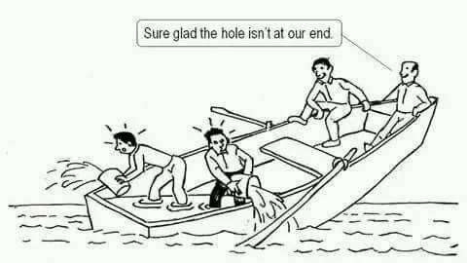
If you decide, as some have expressed, that
“ Canada is probably the safest country in
the world from climate change”, it may well
prove true, but that’s a little like ➔➔
i.e., we’re all in the same boat,
and with the climate, on the same planet!
Think Global, act Local !
Thank you!
QUESTIONS?
COMMENTS?

